Slide 1


Core Principles and Ethical Challenges in Generative AI
Version: 1.0
Course Code: TGS-2025060473
Website: www.tertiarycourses.com.sg
This material belongs to Tertiary Infotech Pte Ltd (UEN: 20120096W). All Rights Reserved

Slide 2
Digital Attendance (Mandatory)
It is mandatory for you to take both AM, PM and Assessment digital attendance for WSQ funded courses.
The trainer or administrator will show you the digital attendance QR code generated from SSG portal.
Please scan the QR code from your mobile phone camera and submit your attendance.
This material belongs to Tertiary Infotech Pte Ltd (UEN: 20120096W). All Rights Reserved

Slide 3
About the Trainer
This material belongs to Tertiary Infotech Pte Ltd (UEN: 20120096W). All Rights Reserved

Slide 4

Let's Know Each Other...
This material belongs to Tertiary Infotech Pte Ltd (UEN: 20120096W). All Rights Reserved

Slide 5
Ground Rules
Set your mobile phone to silent mode
Actively participate in the class. No question is stupid.
Respect each other views. Agree to disagree.
Each person should only speak one at a time.
Be punctual. Back from breaks on time.
Exit the class silently if you need to step out for phone call, toilet break etc.
75% attendance is required for WSQ funding eligibility.
This material belongs to Tertiary Infotech Pte Ltd (UEN: 20120096W). All Rights Reserved

Slide 6
Skills Framework
TSC Title: Generative AI Principles and Applications
TSC Code: ICT-INT-0052-1.1
TSC Description: Generative AI Principles and Applications
Proficiency Level: Level 1
Learning Outcomes:
LU1 (Generative AI Fundamentals)
LO1: Upon completion of this learning unit, participants will be able to demonstrate comprehensive understanding of genera...
LU2 (Prompt Engineering)
LO2: Upon completion of this learning unit, participants will be able to apply advanced prompt engineering techniques and ...
LU3 (Ethical Considerations)
LO3: Upon completion of this learning unit, participants will be able to identify and analyze ethical risks and biases in ...
This material belongs to Tertiary Infotech Pte Ltd (UEN: 20120096W). All Rights Reserved

Slide 7
Knowledge & Ability Statements
LU1: Generative AI Fundamentals
K2: Underlying principles, core concepts and theories governing generative AI
K3: Difference between generative and discriminative models
A4: Demonstrate the use of generation AI in diverse applications (e.g., summarisation, inference, reasoning, transformation of content, augmentation of...
LU2: Prompt Engineering
K1: Importance of data quality, preprocessing, model pipeline and model training (e.g., impact of data bias from training data)
K4: Impact of prompt engineering on the model outputs of generative AI
A3: Apply understanding of generative AI principles to use cases
A5: Analyse generative AI models' performance metrics and evaluate the influence of prompt variations
LU3: Ethical Considerations
K5: Generative AI model workings, including training data, algorithms, and outputs
A1: Analyse limitations and potential biases in AI-generated content
A2: Identify the ethical implications and societal impact of AI-generated content
This material belongs to Tertiary Infotech Pte Ltd (UEN: 20120096W). All Rights Reserved

Slide 8
Course Outline
LU1: Generative AI Fundamentals
T1: Underlying principles, core concepts and theories governing generative AI
T2: Difference between generative and discriminative models
T3: Demonstrate the use of generation AI in diverse applications
LU2: Prompt Engineering
T1: Importance of data quality, preprocessing, model pipeline and model training
T2: Impact of prompt engineering on the model outputs of generative AI
T3: Apply understanding of generative AI principles to use cases
T4: Analyse generative AI models' performance metrics and evaluate the influence of prompt variations
LU3: Ethical Considerations
T1: Generative AI model workings, including training data, algorithms, and outputs
T2: Identify the ethical implications and societal impact of AI-generated content
T3: Analyse limitations and potential biases in AI-generated content
This material belongs to Tertiary Infotech Pte Ltd (UEN: 20120096W). All Rights Reserved

Slide 9
Assessment Methods & Briefing
Assessment: Written Assessment
Assessment format: Open Book
Open book assessment allows you to reference your learning materials.
Duration: As per course schedule
Grading: Competent / Not Yet Competent
Assessment Rules:
Place phones & other materials under the table
No photos or recording of assessment scripts
No discussion with other learners during assessment
Raise your hand if you have any questions
This material belongs to Tertiary Infotech Pte Ltd (UEN: 20120096W). All Rights Reserved

Slide 10
Criteria for Funding
Minimum attendance rate of 75% based on SSG Digital Attendance record.
Complete the assessment and be assessed as 'Competent'.
Complete the TRAQOM survey.
For more information on WSQ funding:
Visit SkillsFuture portal: www.skillsfuture.gov.sg
Eligible individuals may use SkillsFuture Credit to offset course fees.
This material belongs to Tertiary Infotech Pte Ltd (UEN: 20120096W). All Rights Reserved

Slide 11

LMS/TMS
https://lms-tms.tertiaryinfotech.com

Slide 12
LO1 | LU1 | T1: Underlying principles, core concepts and theories governing generative AI

Slide 13
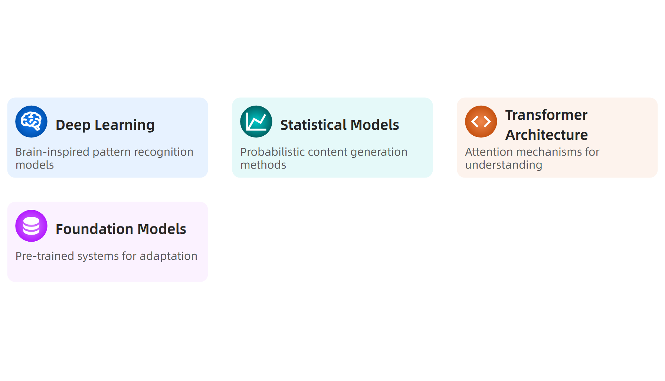
What is Underlying principles, core concepts and theories governing generative AI?
Source: IBM, WIPO 2024
This material belongs to Tertiary Infotech Pte Ltd (UEN: 20120096W). All Rights Reserved

Slide 14
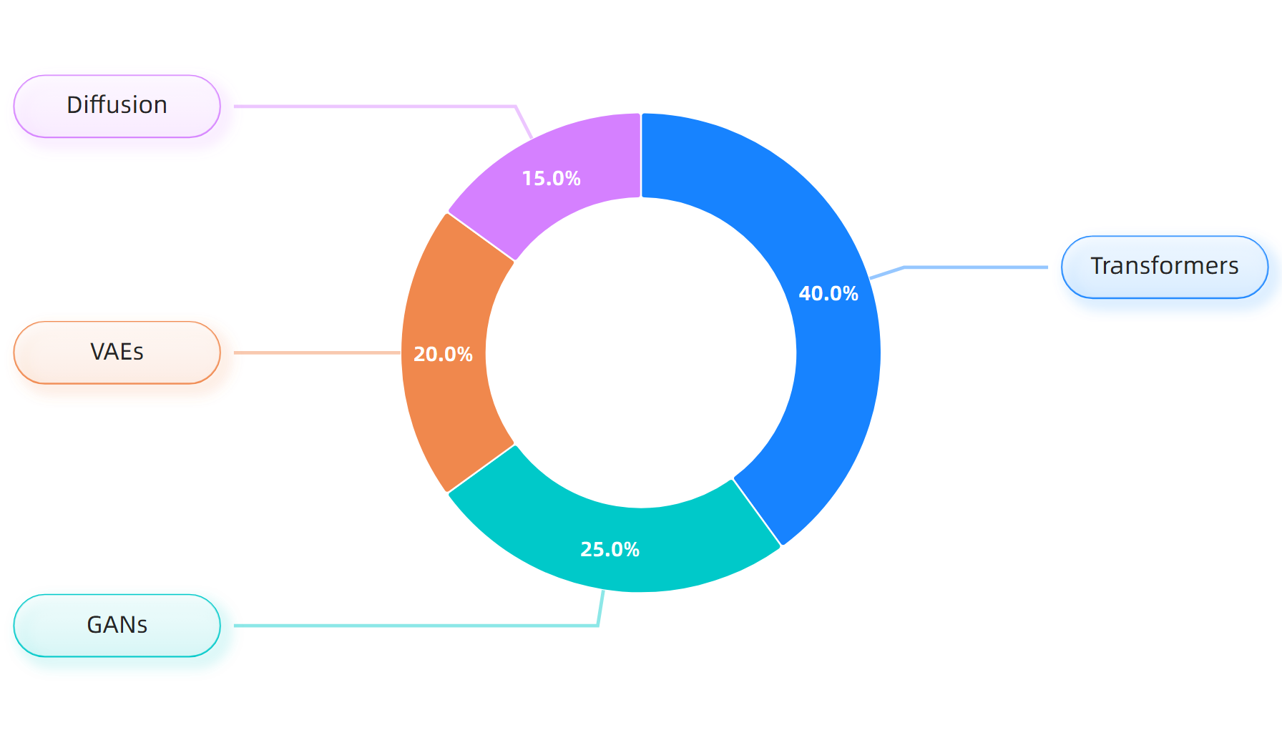
Model Architecture Types
Source: WIPO Patent Landscape 2024
This material belongs to Tertiary Infotech Pte Ltd (UEN: 20120096W). All Rights Reserved

Slide 15
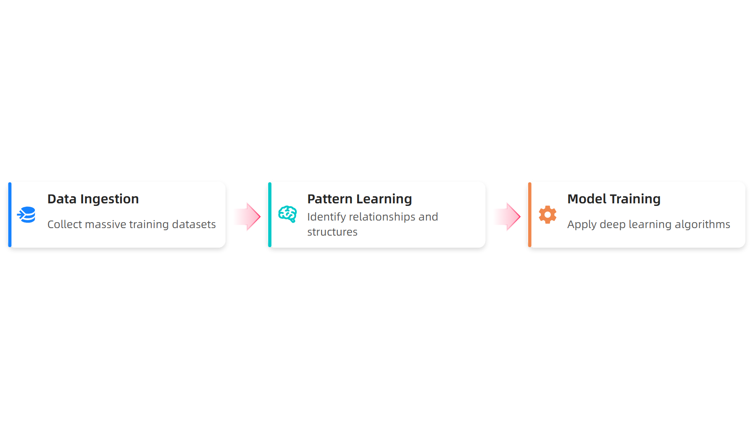
Generation Process
Source: IBM, Carnegie Mellon 2024
This material belongs to Tertiary Infotech Pte Ltd (UEN: 20120096W). All Rights Reserved

Slide 16
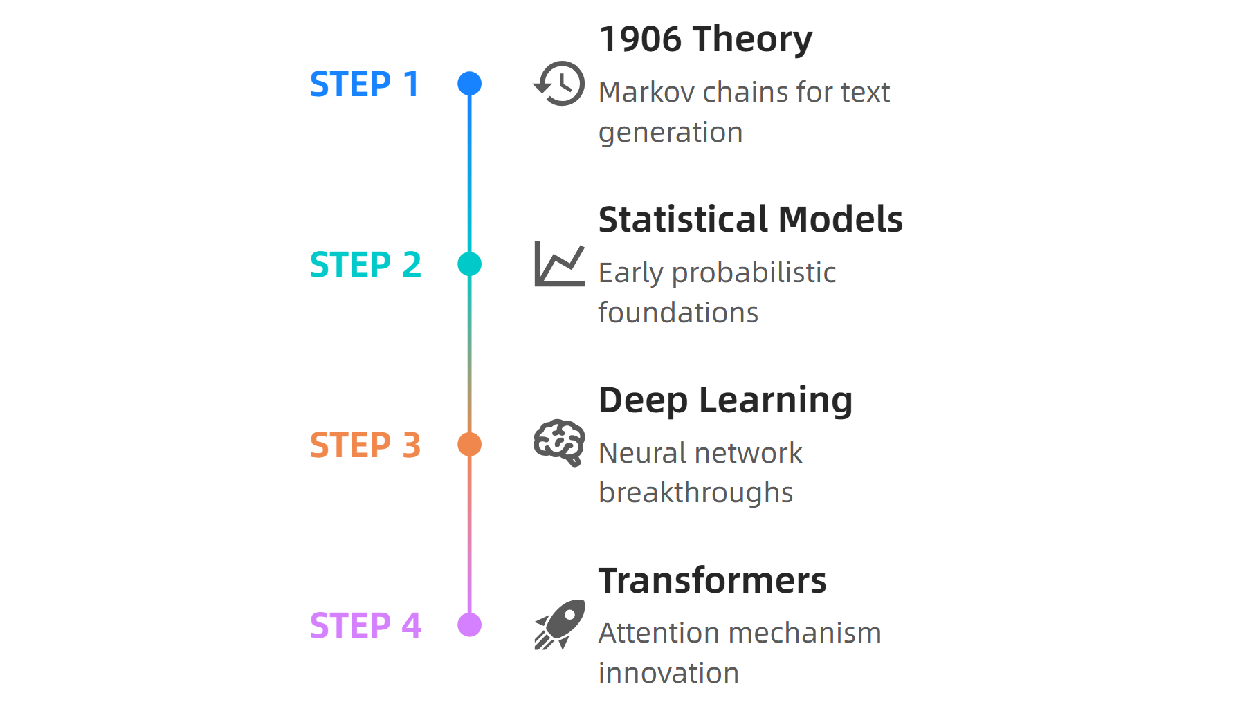
Theoretical Foundations
Source: Wikipedia, Carnegie Mellon 2024
This material belongs to Tertiary Infotech Pte Ltd (UEN: 20120096W). All Rights Reserved

Slide 17
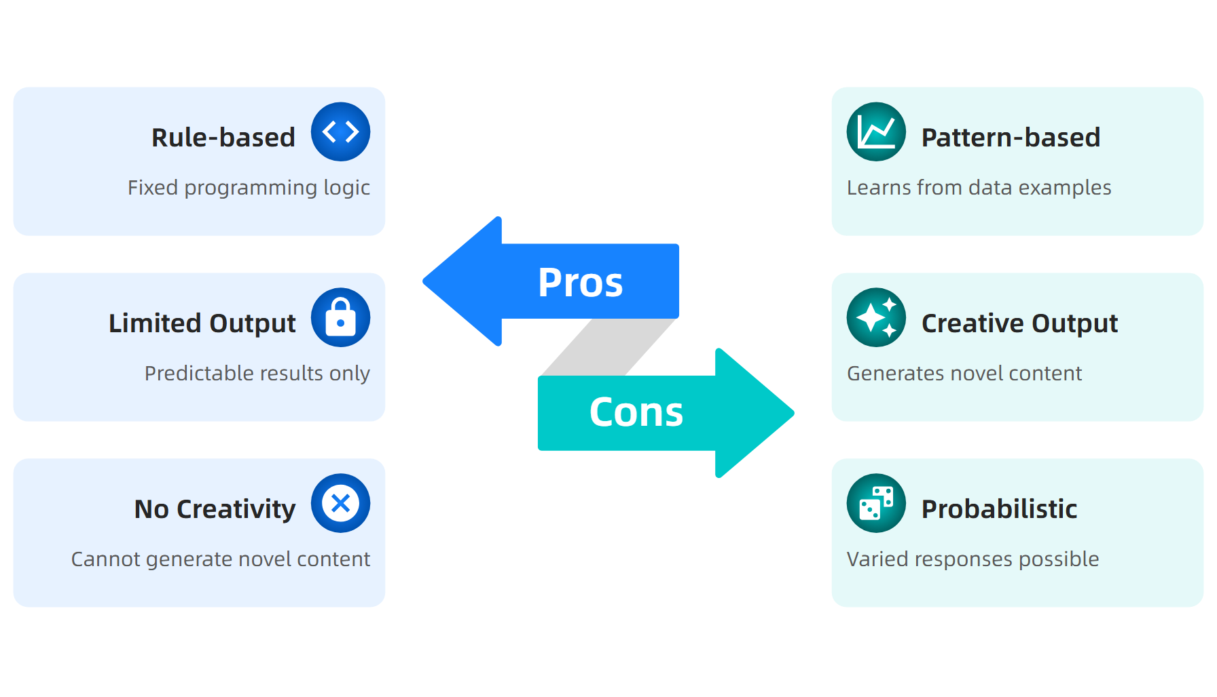
Traditional vs Generative AI
Source: Research Summary Analysis 2024
This material belongs to Tertiary Infotech Pte Ltd (UEN: 20120096W). All Rights Reserved

Slide 18
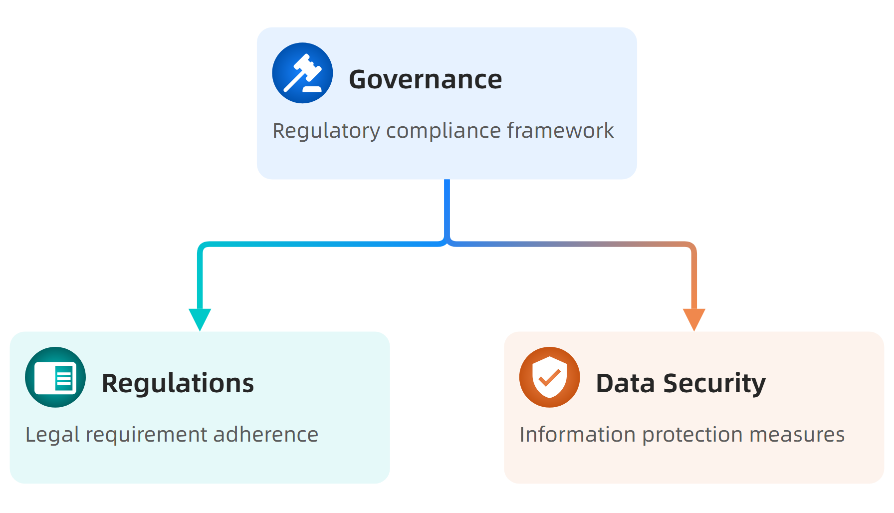
Responsible AI Framework
Source: PMC Responsible AI Framework 2024
This material belongs to Tertiary Infotech Pte Ltd (UEN: 20120096W). All Rights Reserved

Slide 19
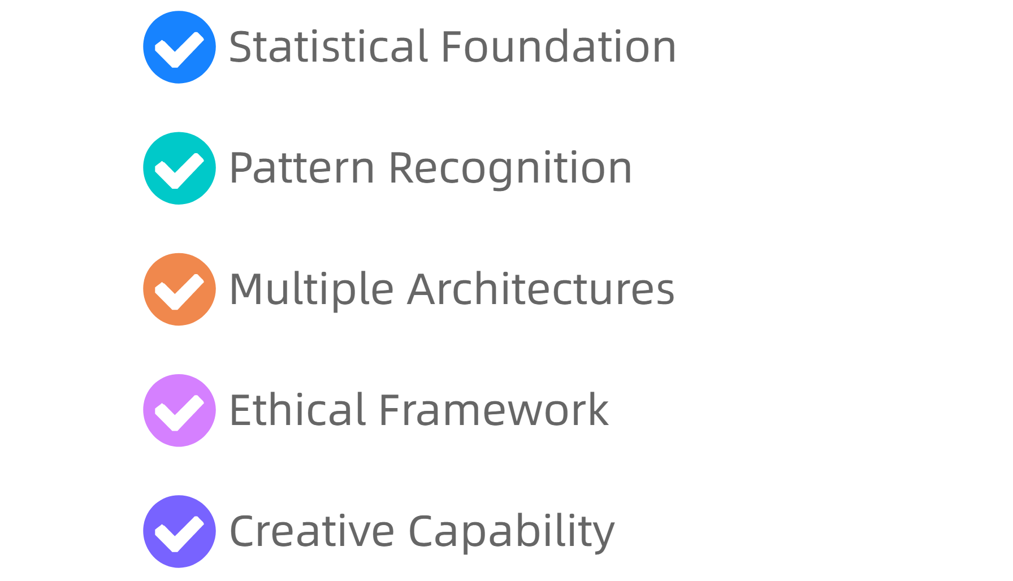
Key Takeaways
Source: Comprehensive Research Analysis 2024
This material belongs to Tertiary Infotech Pte Ltd (UEN: 20120096W). All Rights Reserved

Slide 20
Activity: Underlying principles, core concepts and theories governing generative AI
Activity: AI Model Classification Exercise
Scenario: Your organization is evaluating different generative AI solutions for content creation. You need to assess which model type best fits specific use cases.
Step 1: Review four use cases (text generation, image creation, data synthesis, creative writing)
Step 2: Match each use case to appropriate model type (Transformer, GAN, VAE, Diffusion)
Step 3: Justify selection based on model capabilities and theoretical foundations
Step 4: Identify ethical considerations for each implementation
Expected Output: Completed classification matrix with justifications and ethical assessment
Duration: 20 minutes
This material belongs to Tertiary Infotech Pte Ltd (UEN: 20120096W). All Rights Reserved

Slide 21
LO1 | LU1 | T2: Difference between generative and discriminative models

Slide 22
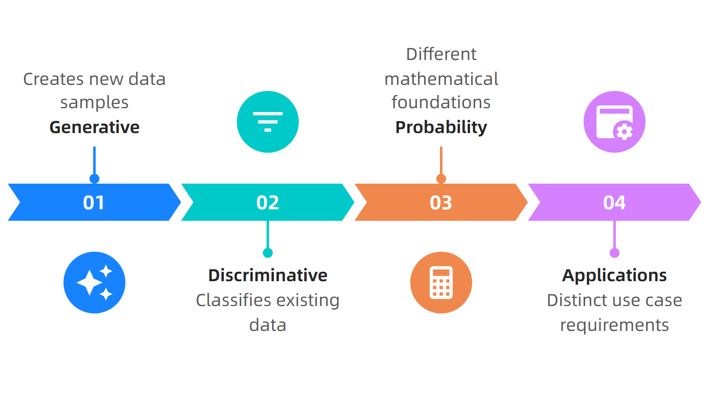
What is Difference between generative and discriminative models?
Source: DataCamp, 2024
This material belongs to Tertiary Infotech Pte Ltd (UEN: 20120096W). All Rights Reserved

Slide 23
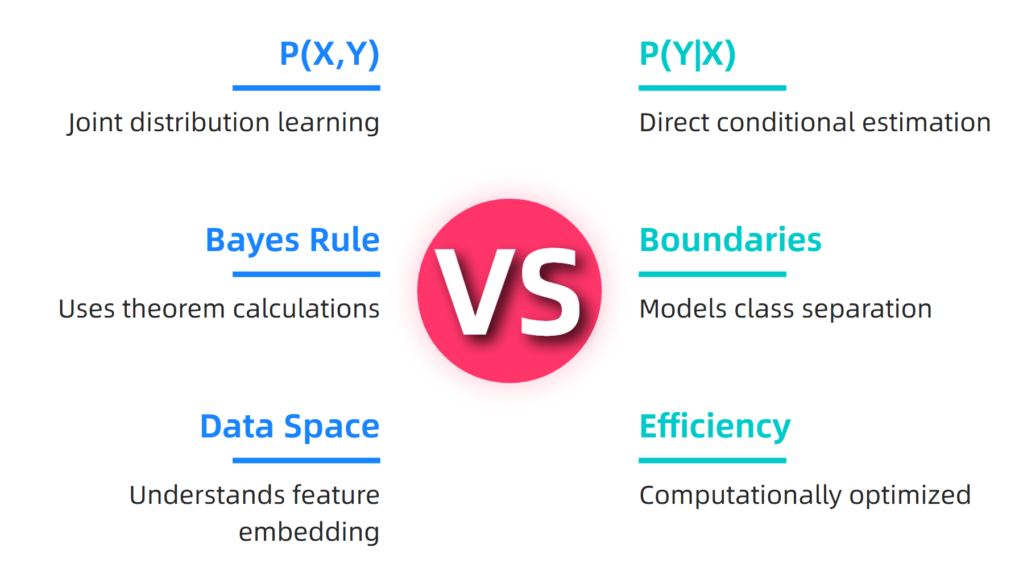
Mathematical Foundation
Source: GeeksforGeeks, 2024
This material belongs to Tertiary Infotech Pte Ltd (UEN: 20120096W). All Rights Reserved

Slide 24
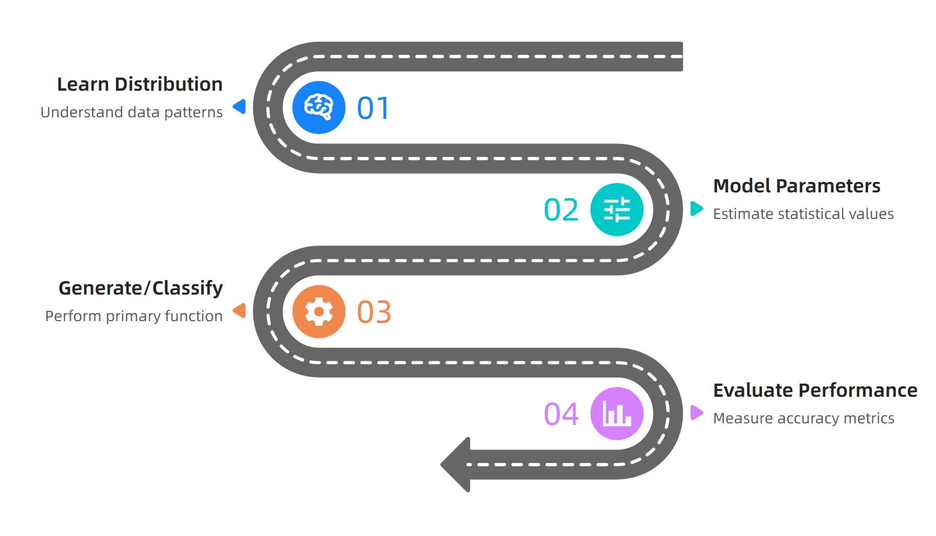
Model Characteristics
Source: Coursera, 2024
This material belongs to Tertiary Infotech Pte Ltd (UEN: 20120096W). All Rights Reserved

Slide 25
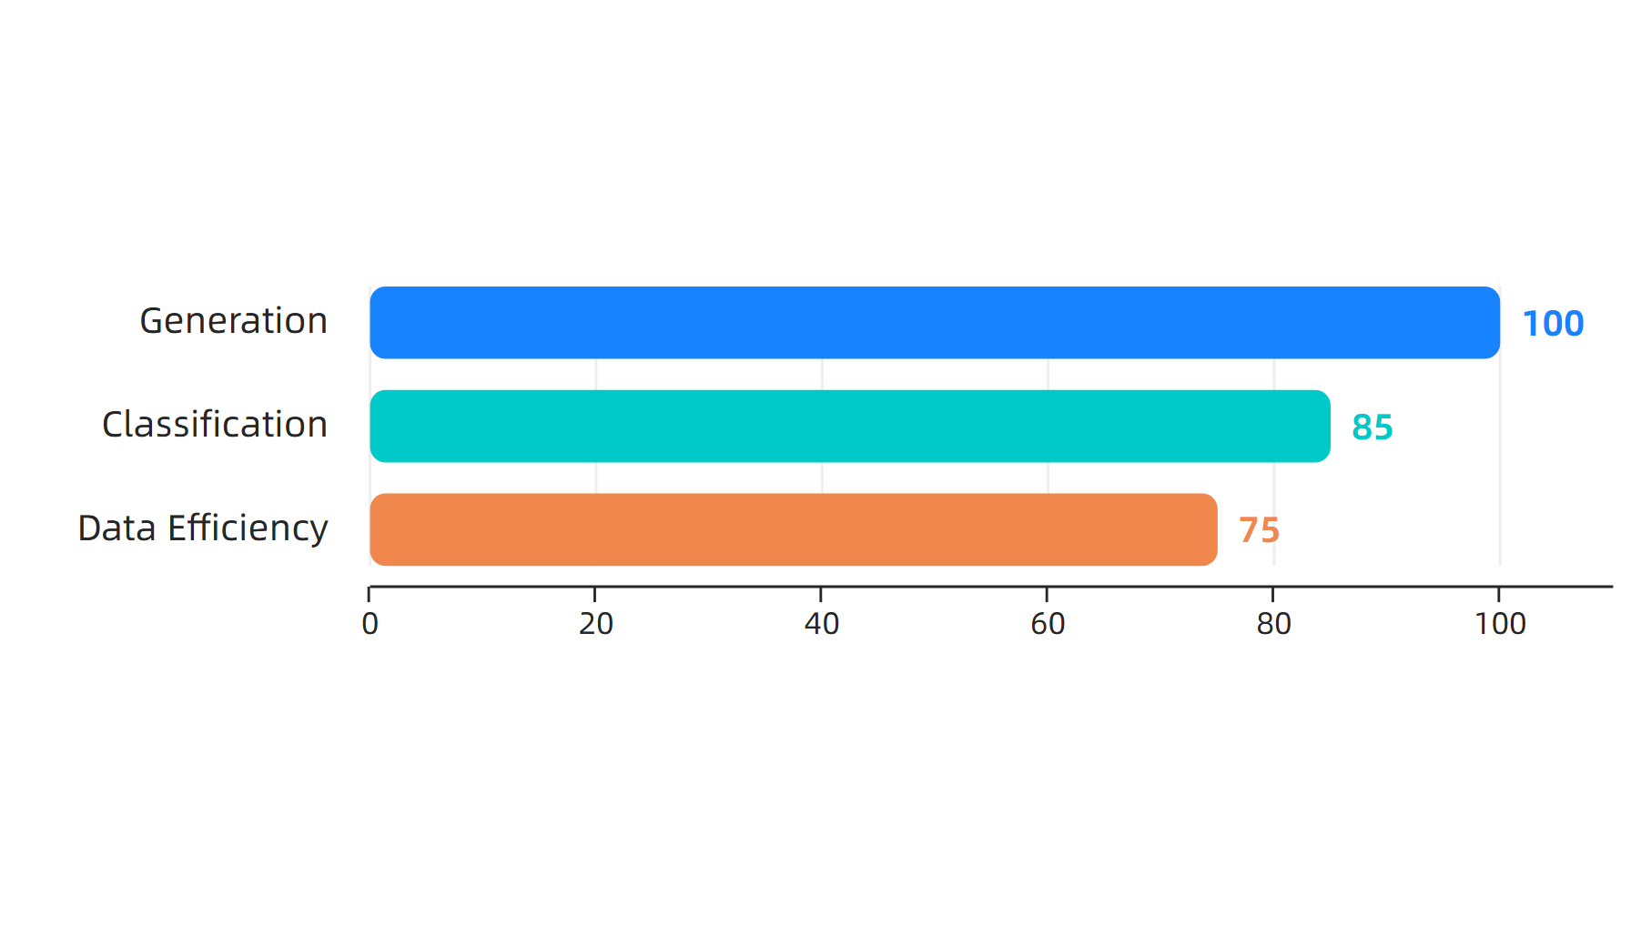
Performance Statistics
Source: DataCamp & GeeksforGeeks, 2024
This material belongs to Tertiary Infotech Pte Ltd (UEN: 20120096W). All Rights Reserved

Slide 26
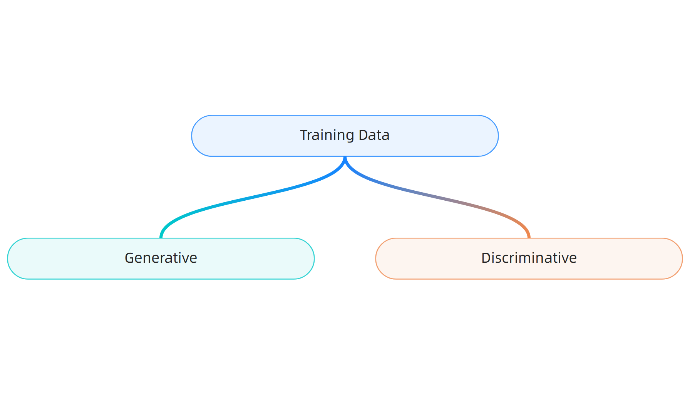
Training Requirements
Source: TutorialsPoint, 2024
This material belongs to Tertiary Infotech Pte Ltd (UEN: 20120096W). All Rights Reserved

Slide 27
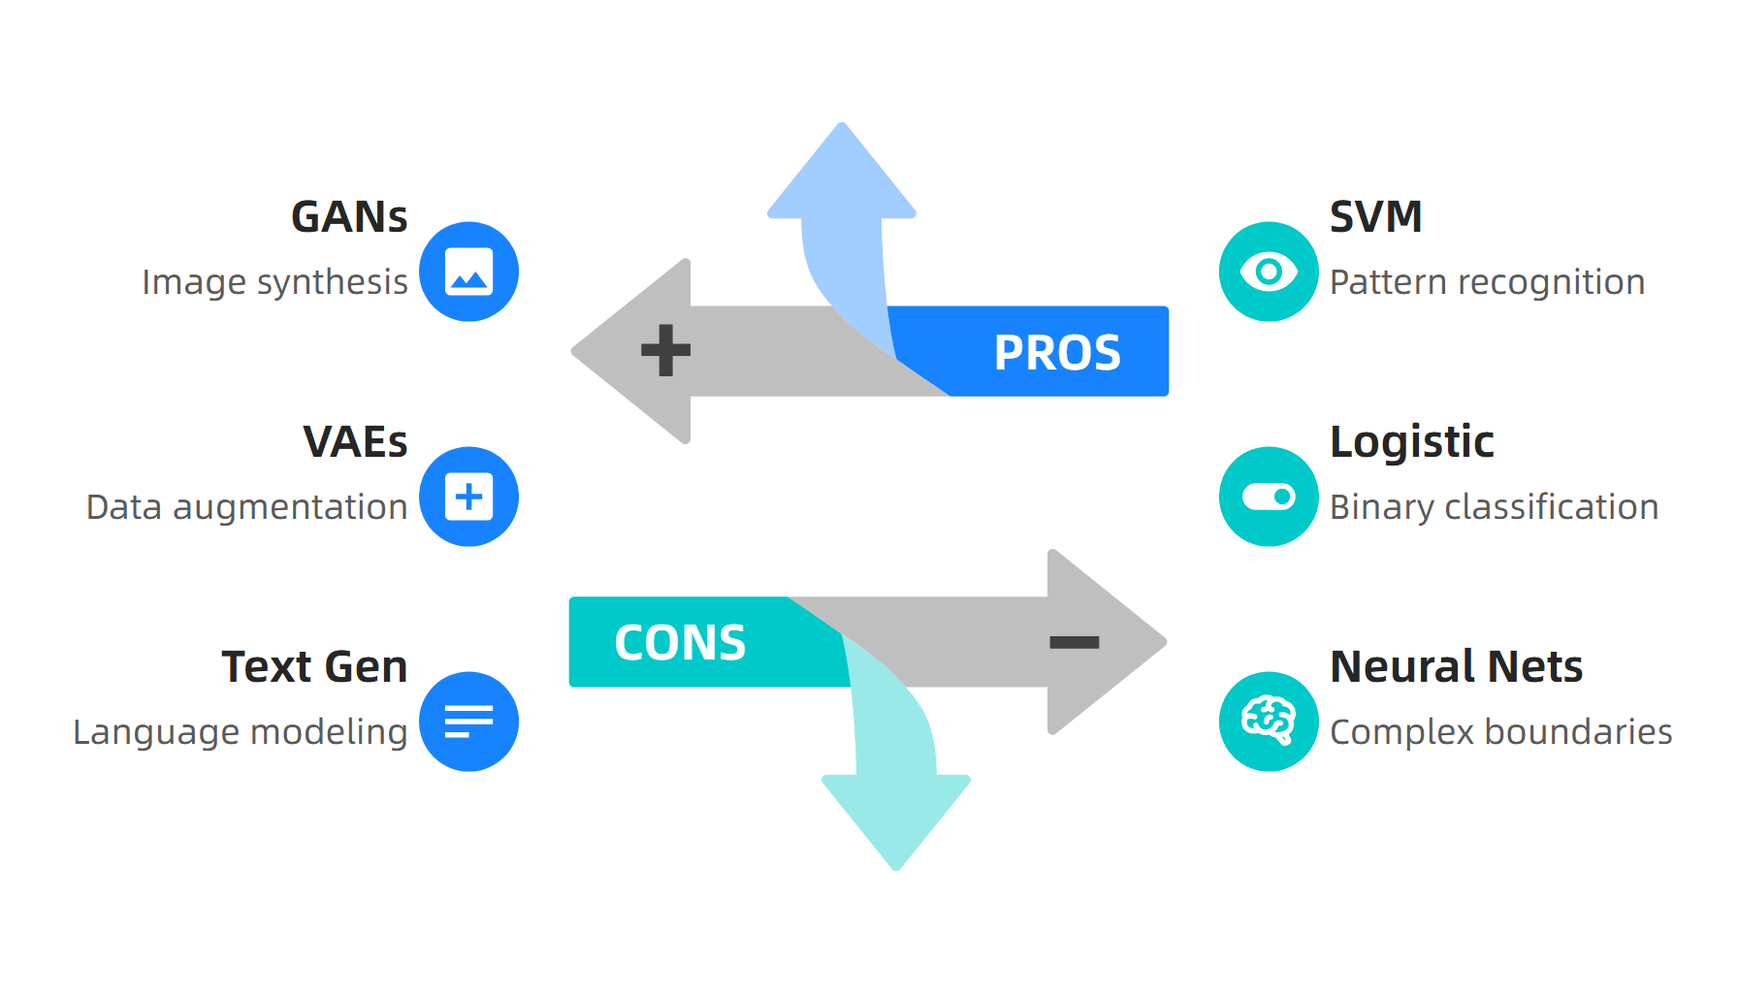
Application Examples
Source: GeeksforGeeks & Wikipedia, 2024
This material belongs to Tertiary Infotech Pte Ltd (UEN: 20120096W). All Rights Reserved

Slide 28
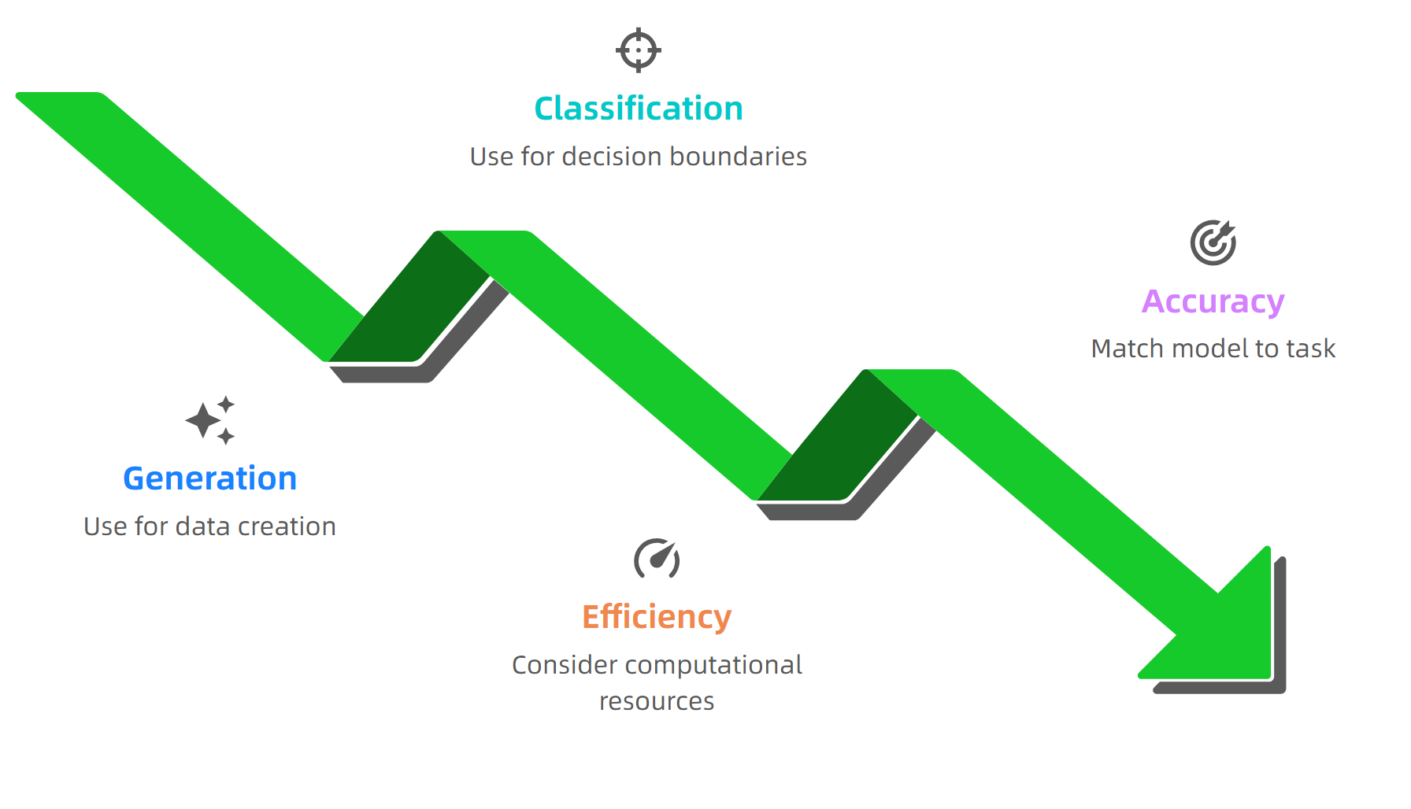
Key Takeaways
Source: DataCamp & Coursera, 2024
This material belongs to Tertiary Infotech Pte Ltd (UEN: 20120096W). All Rights Reserved

Slide 29
Activity: Difference between generative and discriminative models
Activity: Model Type Selection
Scenario: Your team needs to choose between generative and discriminative models for a customer recommendation system that must both classify user preferences and generate personalized content suggestions.
Step 1: Analyze business requirements for classification vs generation
Step 2: Evaluate available training data size and quality
Step 3: Compare computational resources and accuracy needs
Step 4: Recommend appropriate model type with justification
Expected Output: Written recommendation with model choice rationale
Duration: 20 minutes
This material belongs to Tertiary Infotech Pte Ltd (UEN: 20120096W). All Rights Reserved

Slide 30
LO1 | LU1 | T3: Demonstrate the use of generation AI in diverse applications

Slide 31
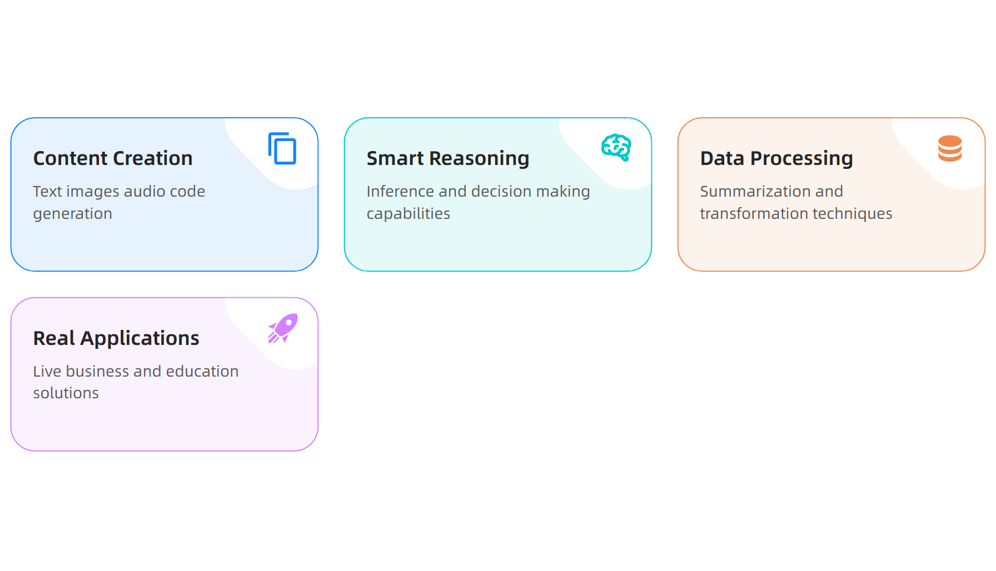
What is Demonstrate the use of generation AI in diverse applications?
Source: Complete Guide to Generative AI Applications, 2026
This material belongs to Tertiary Infotech Pte Ltd (UEN: 20120096W). All Rights Reserved

Slide 32
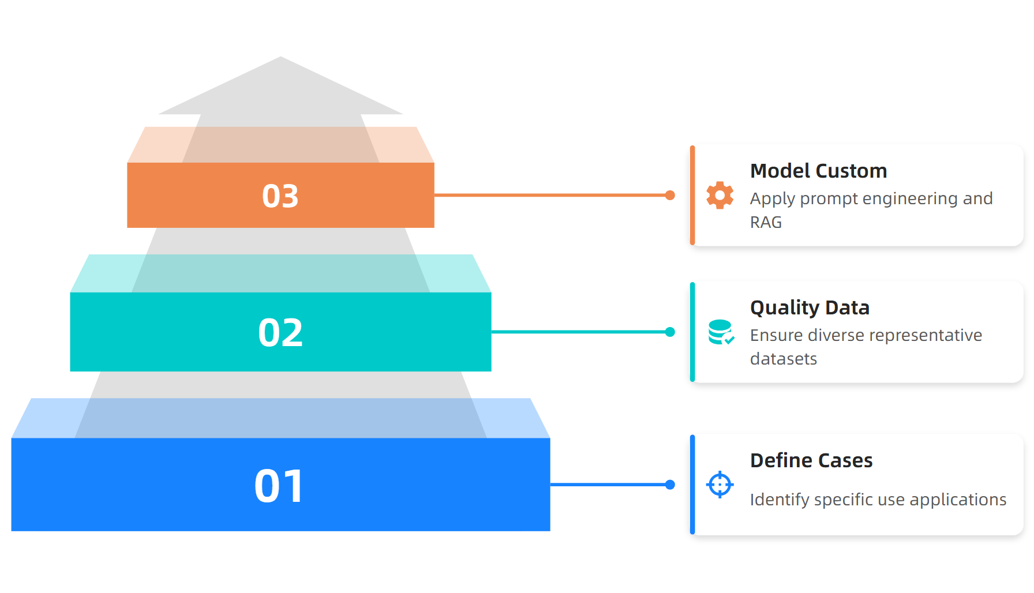
GenAI Implementation Process
Source: Best practices to build generative AI applications on AWS, 2024
This material belongs to Tertiary Infotech Pte Ltd (UEN: 20120096W). All Rights Reserved

Slide 33
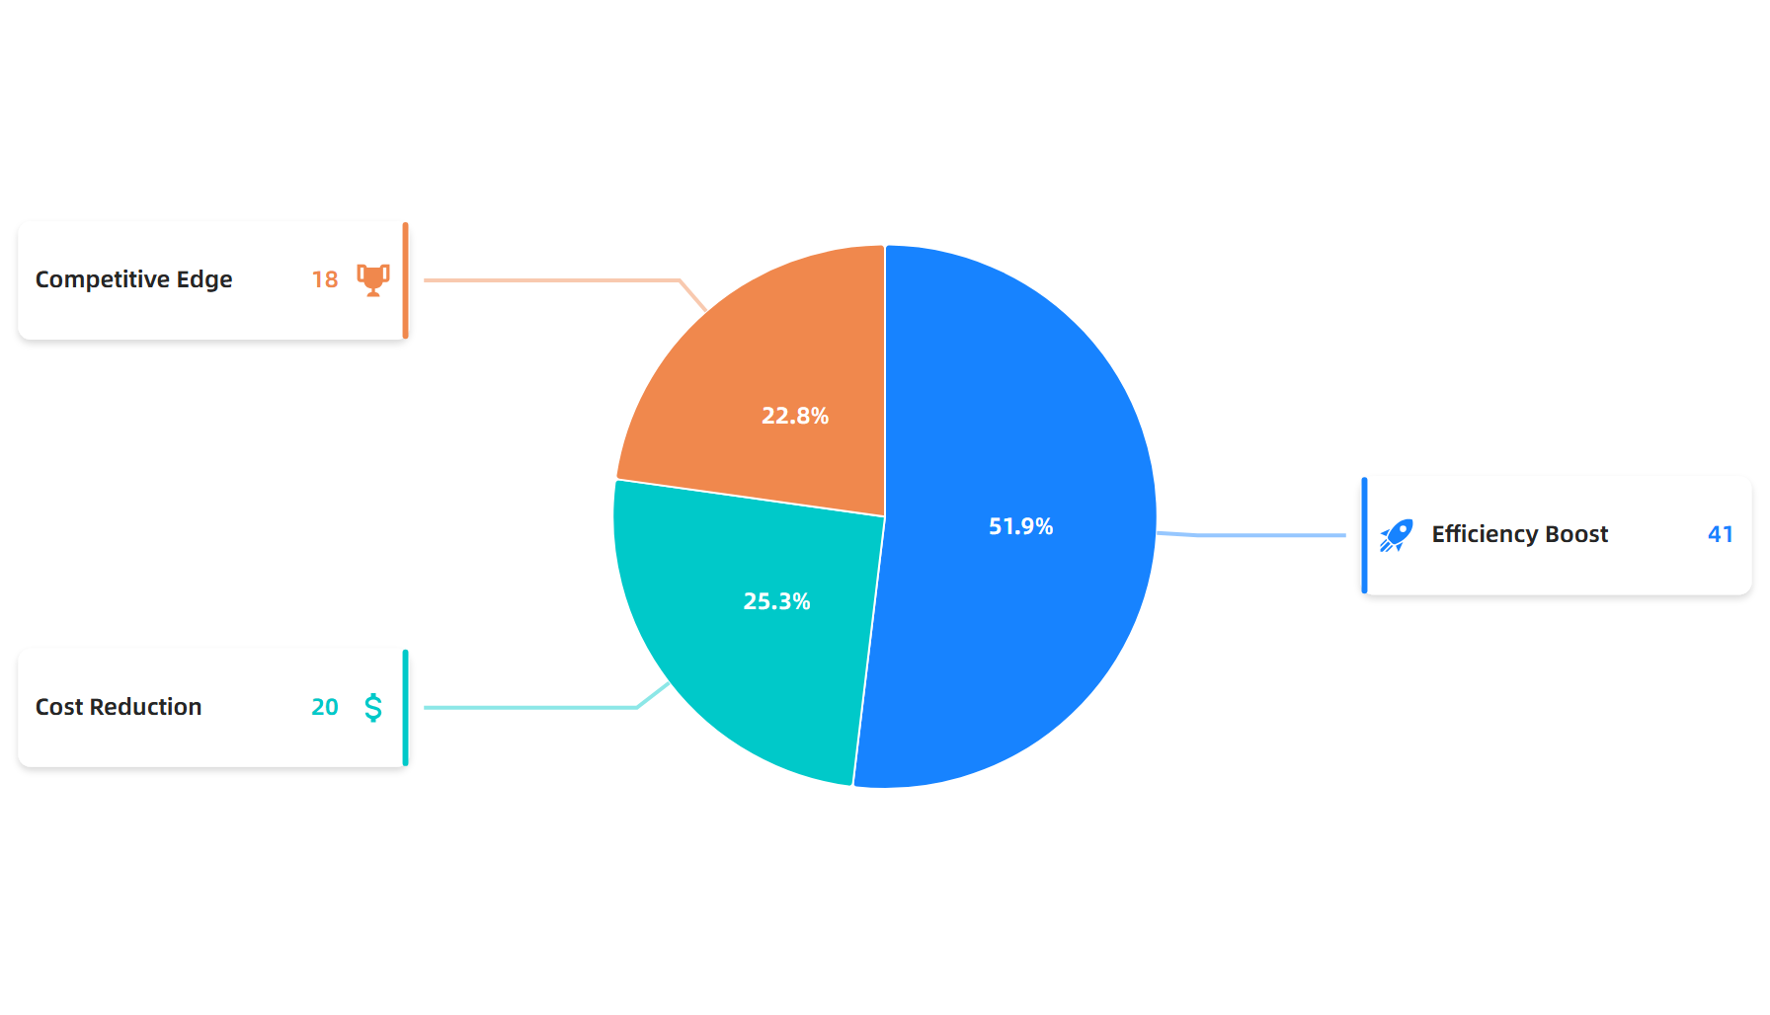
Adoption Drivers and Statistics
Source: Top 125 Generative AI Applications, 2025
This material belongs to Tertiary Infotech Pte Ltd (UEN: 20120096W). All Rights Reserved

Slide 34
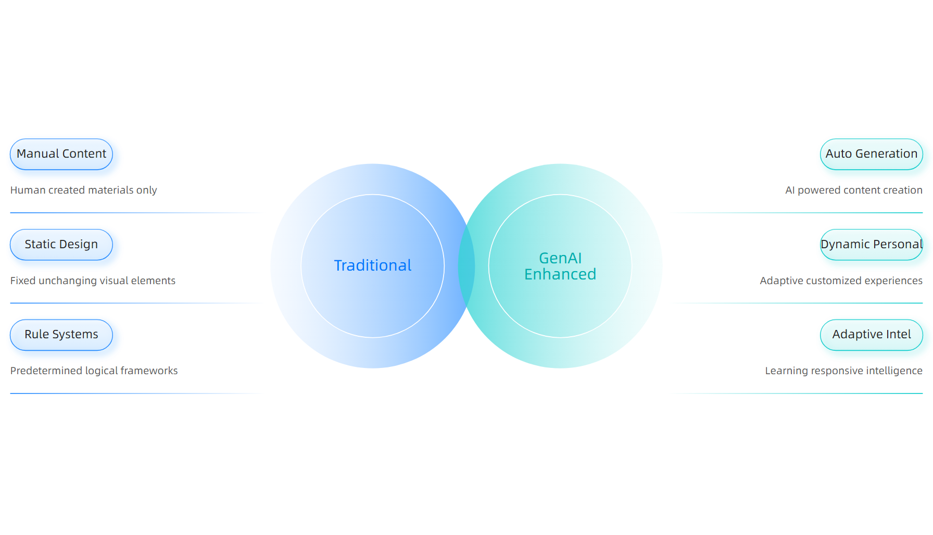
Traditional vs GenAI Enhanced Approaches
Source: Generative AI | Microsoft Learn, 2025
This material belongs to Tertiary Infotech Pte Ltd (UEN: 20120096W). All Rights Reserved

Slide 35
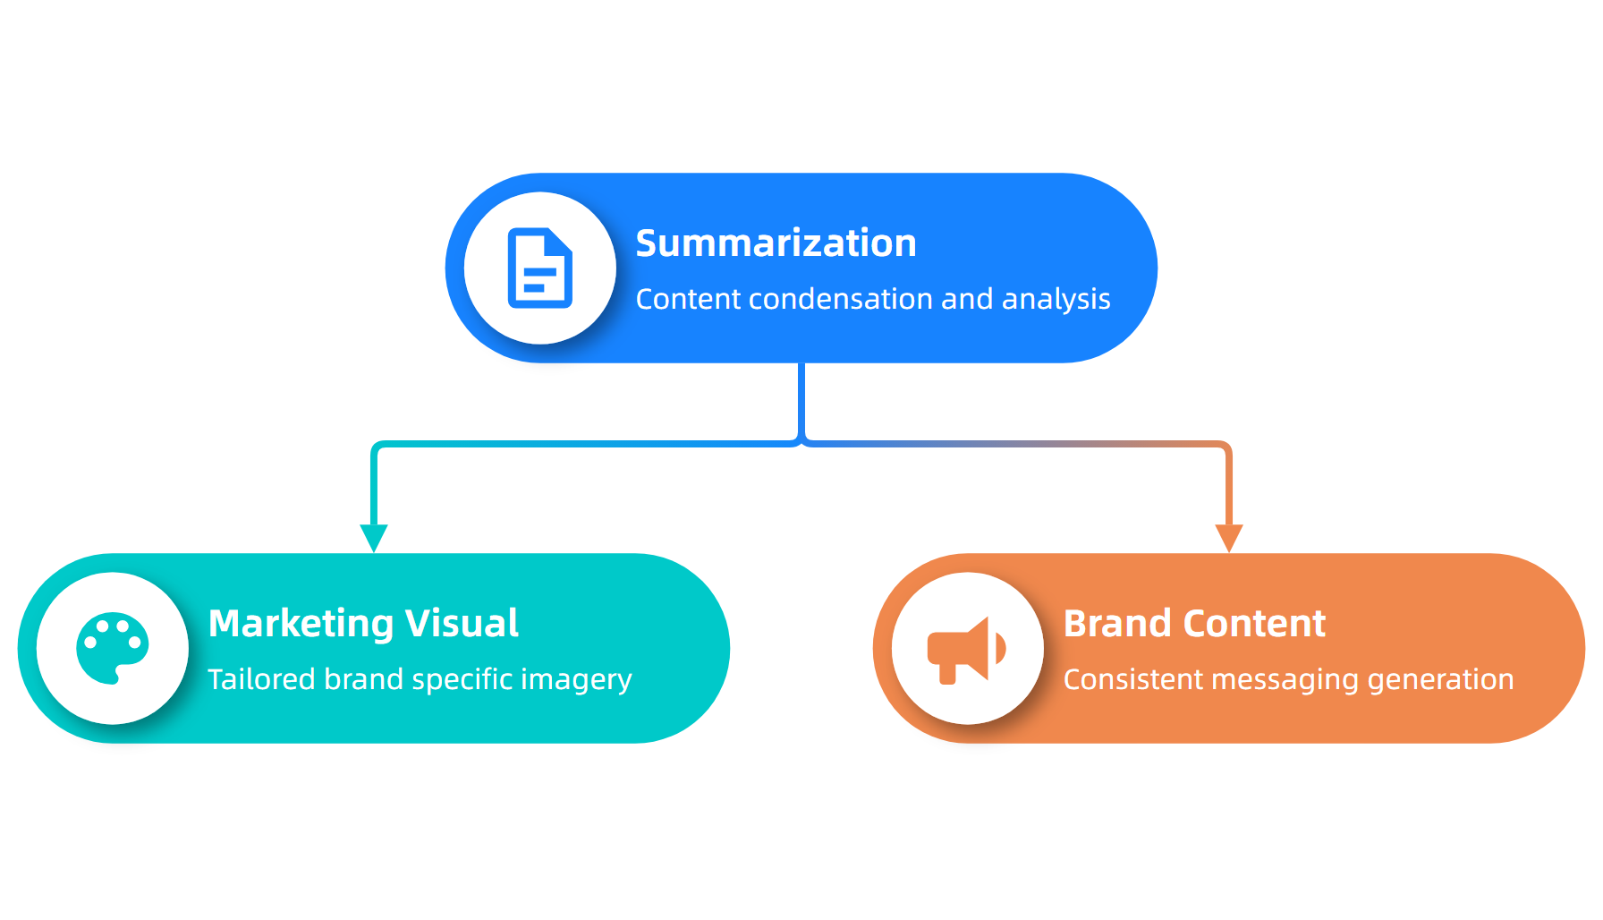
Content Applications Hierarchy
Source: Complete Guide to Generative AI Applications, 2026
This material belongs to Tertiary Infotech Pte Ltd (UEN: 20120096W). All Rights Reserved

Slide 36
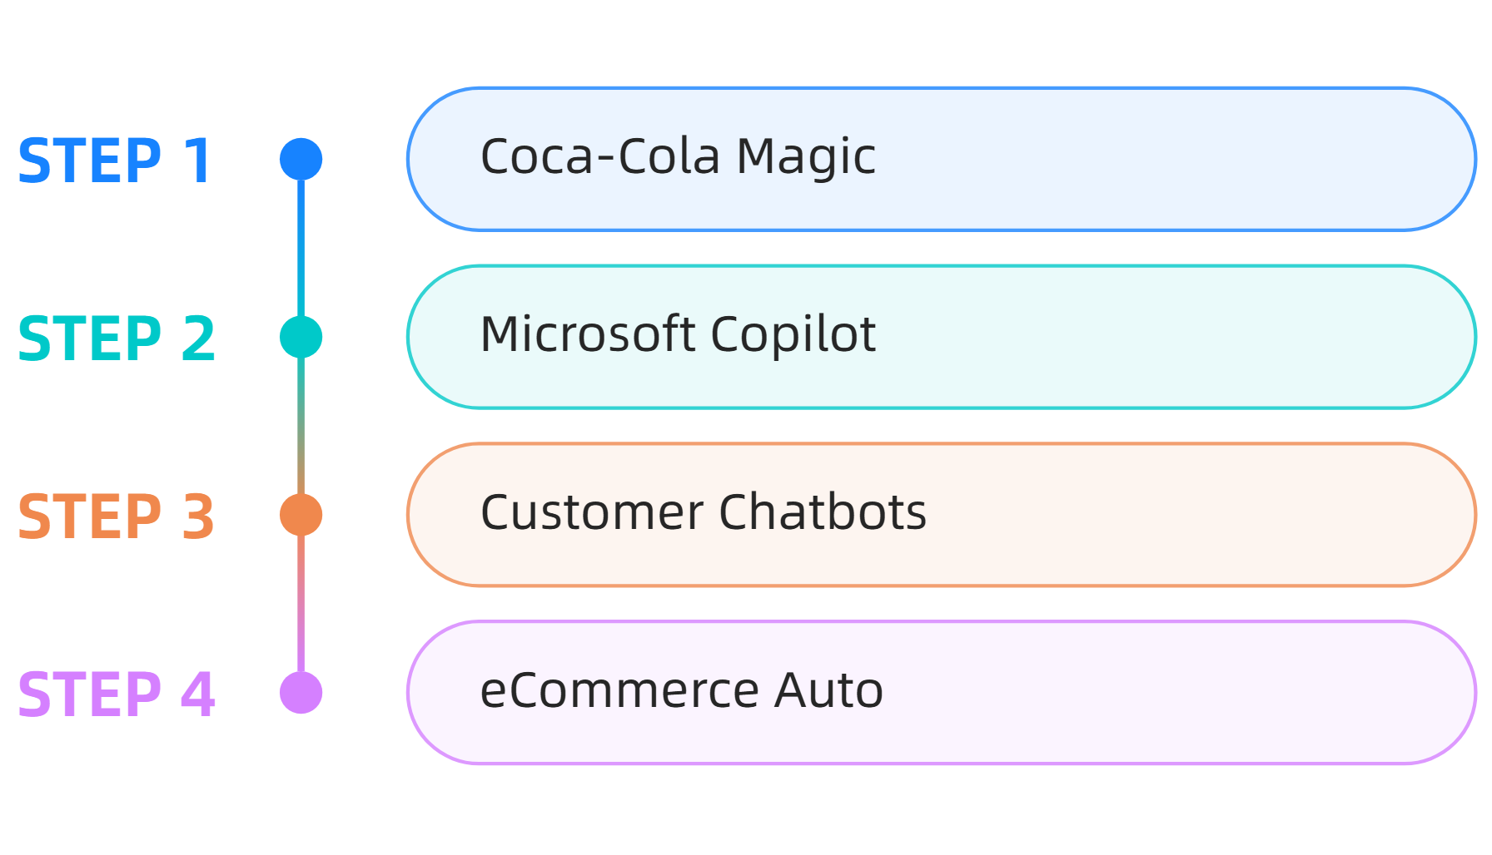
Real-World Success Stories
Source: Top 125 Generative AI Applications, 2025
This material belongs to Tertiary Infotech Pte Ltd (UEN: 20120096W). All Rights Reserved

Slide 37
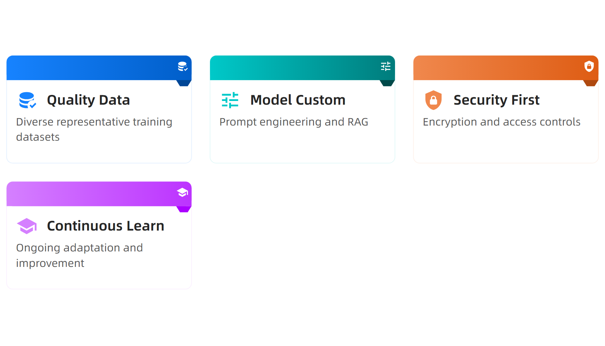
Key Implementation Takeaways
Source: Best practices to build generative AI applications on AWS, 2024
This material belongs to Tertiary Infotech Pte Ltd (UEN: 20120096W). All Rights Reserved

Slide 38
Activity: Demonstrate the use of generation AI in diverse applications
Activity: GenAI Application Analysis
Scenario: Your organization wants to implement GenAI for customer service. Evaluate three potential applications: chatbot automation, content summarization, and personalized responses. Assess implementation requirements and expected outcomes.
Step 1: Identify specific use cases for each application type
Step 2: Evaluate data quality requirements and security considerations
Step 3: Design implementation timeline with customization needs
Step 4: Present recommendations with expected ROI metrics
Expected Output: Comprehensive implementation plan with justified application selection
Duration: 25 minutes
This material belongs to Tertiary Infotech Pte Ltd (UEN: 20120096W). All Rights Reserved

Slide 39
LO2 | LU2 | T1: Importance of data quality, preprocessing, model pipeline and model training

Slide 40
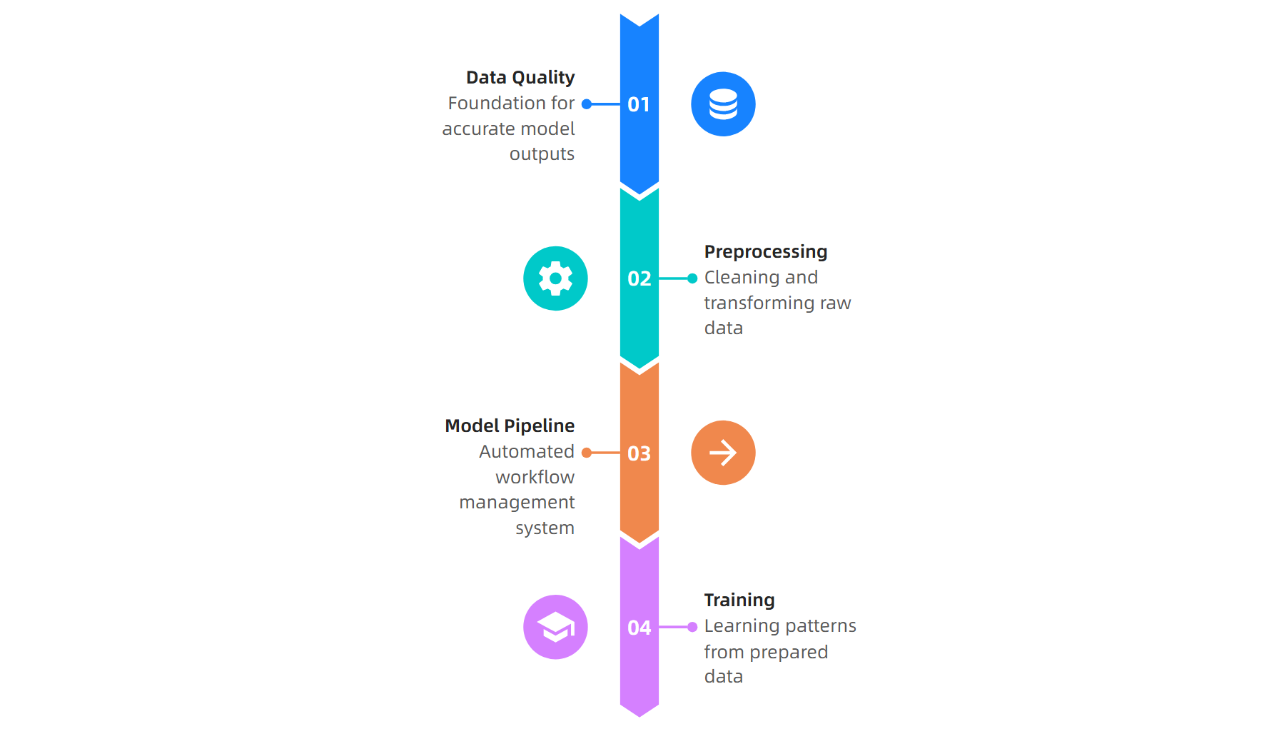
What is Importance of data quality, preprocessing, model pipeline and model training?
Source: DataCamp, 2024
This material belongs to Tertiary Infotech Pte Ltd (UEN: 20120096W). All Rights Reserved

Slide 41
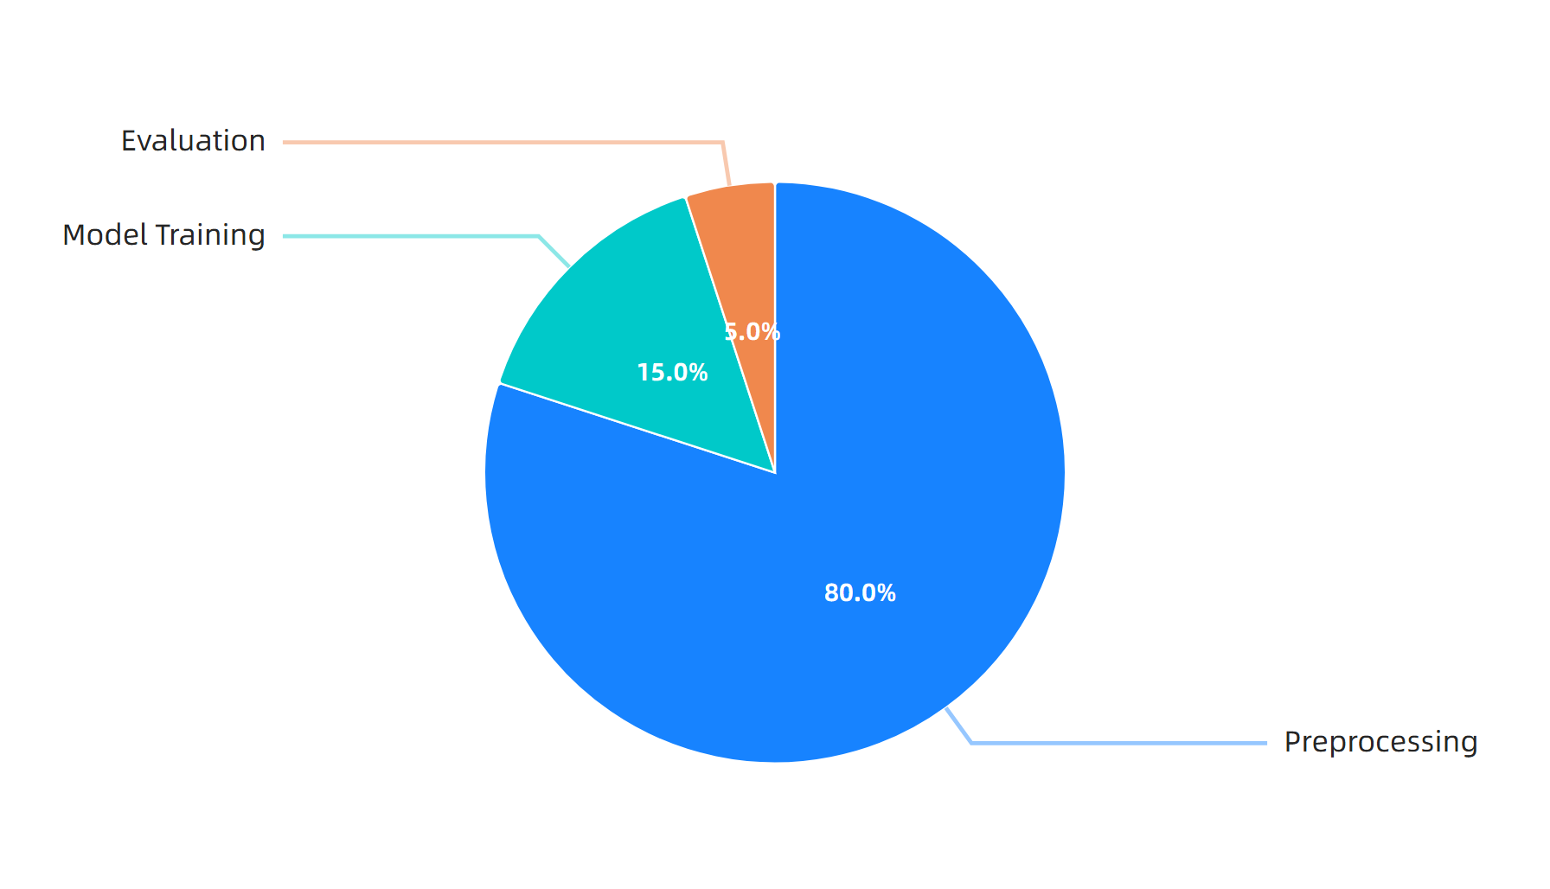
Data practitioner time allocation
Source: LakeFS, 2024
This material belongs to Tertiary Infotech Pte Ltd (UEN: 20120096W). All Rights Reserved

Slide 42
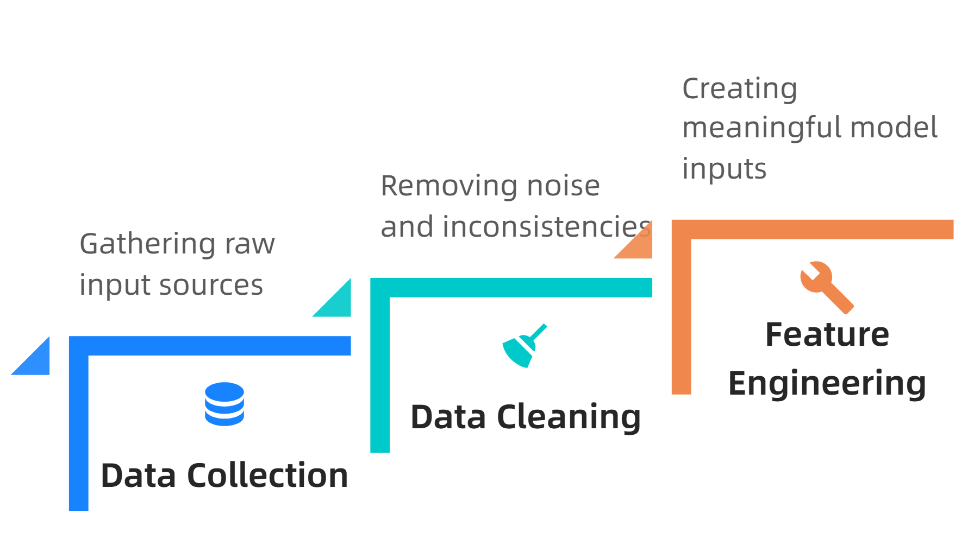
ML pipeline workflow stages
Source: Dagster, 2024
This material belongs to Tertiary Infotech Pte Ltd (UEN: 20120096W). All Rights Reserved

Slide 43
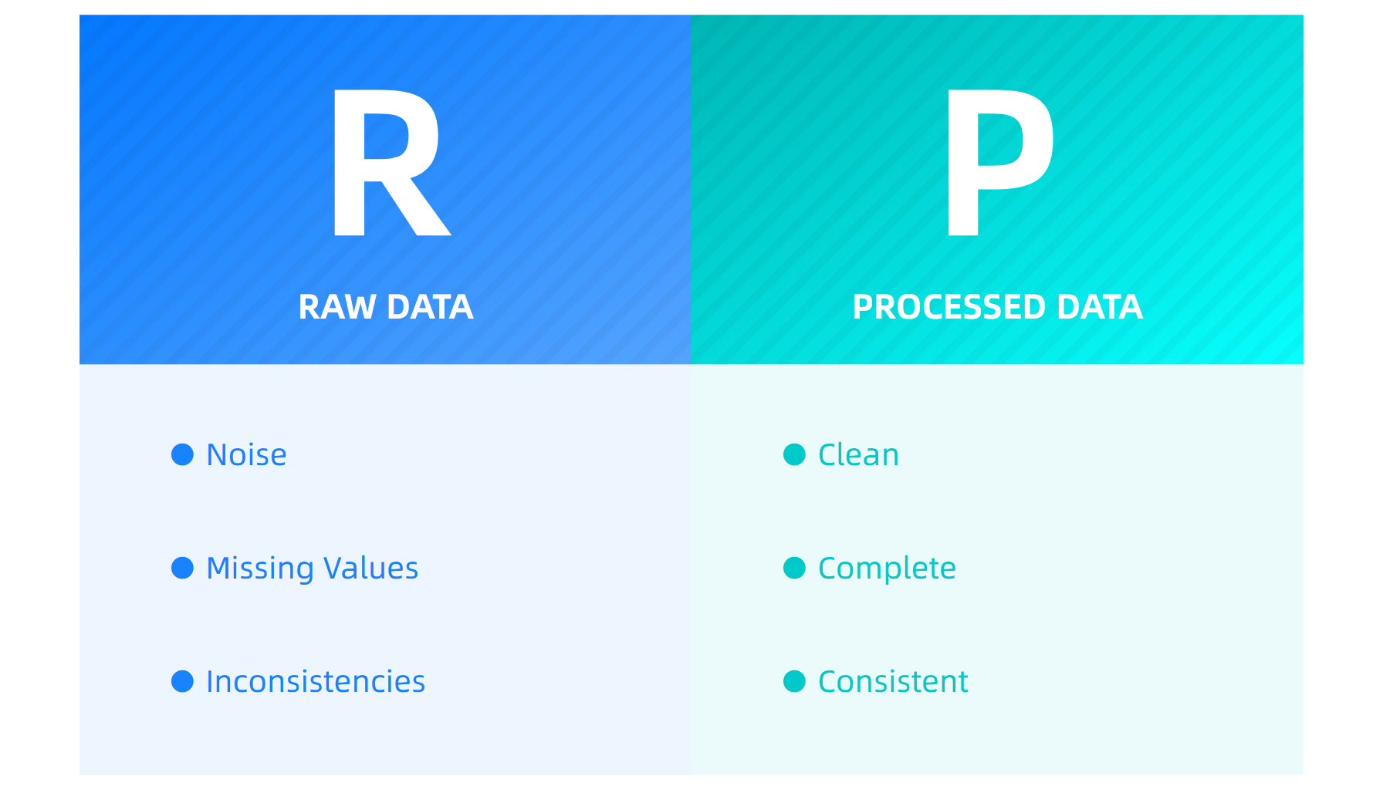
Raw vs processed data comparison
Source: Couchbase Blog, 2024
This material belongs to Tertiary Infotech Pte Ltd (UEN: 20120096W). All Rights Reserved

Slide 44
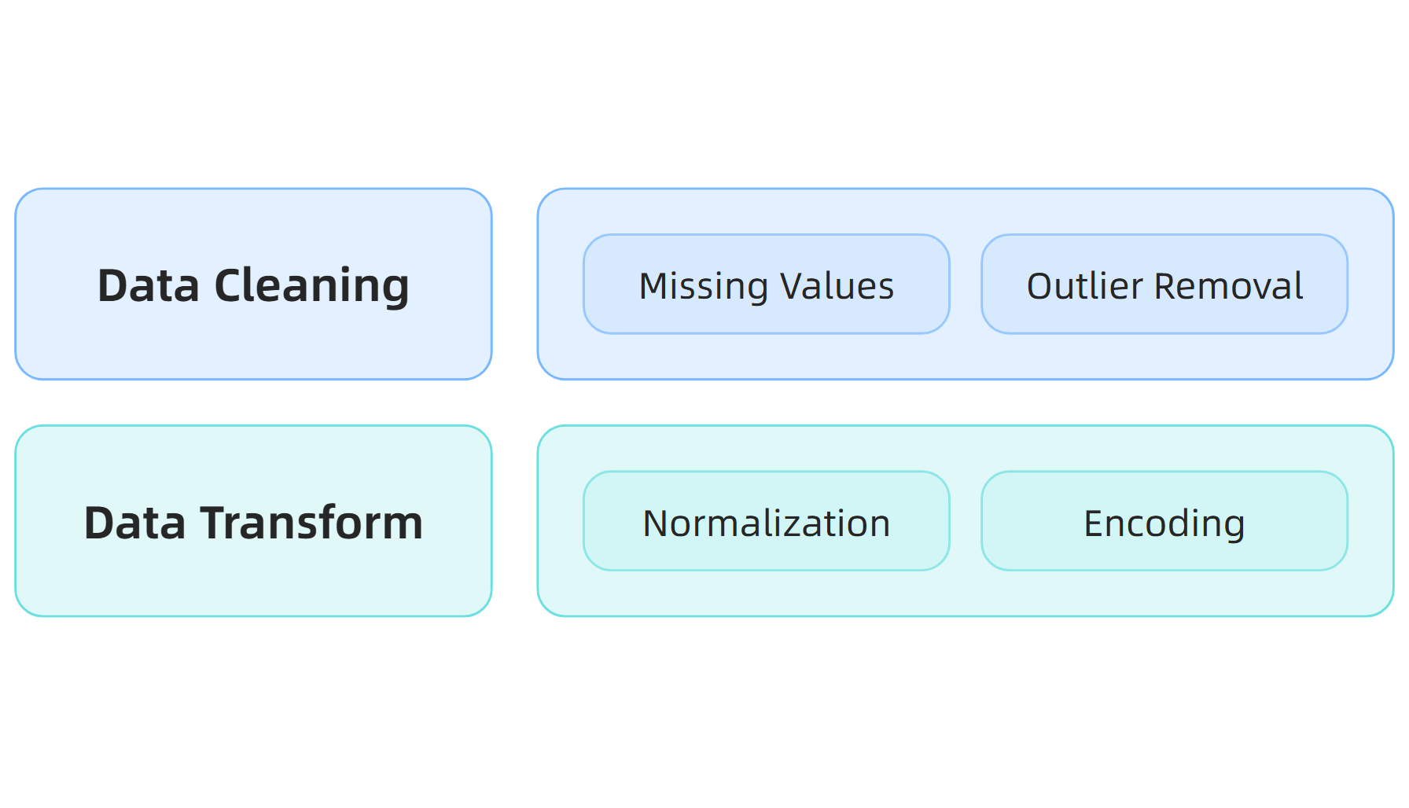
Data preprocessing techniques hierarchy
Source: TensorFlow, 2024
This material belongs to Tertiary Infotech Pte Ltd (UEN: 20120096W). All Rights Reserved

Slide 45
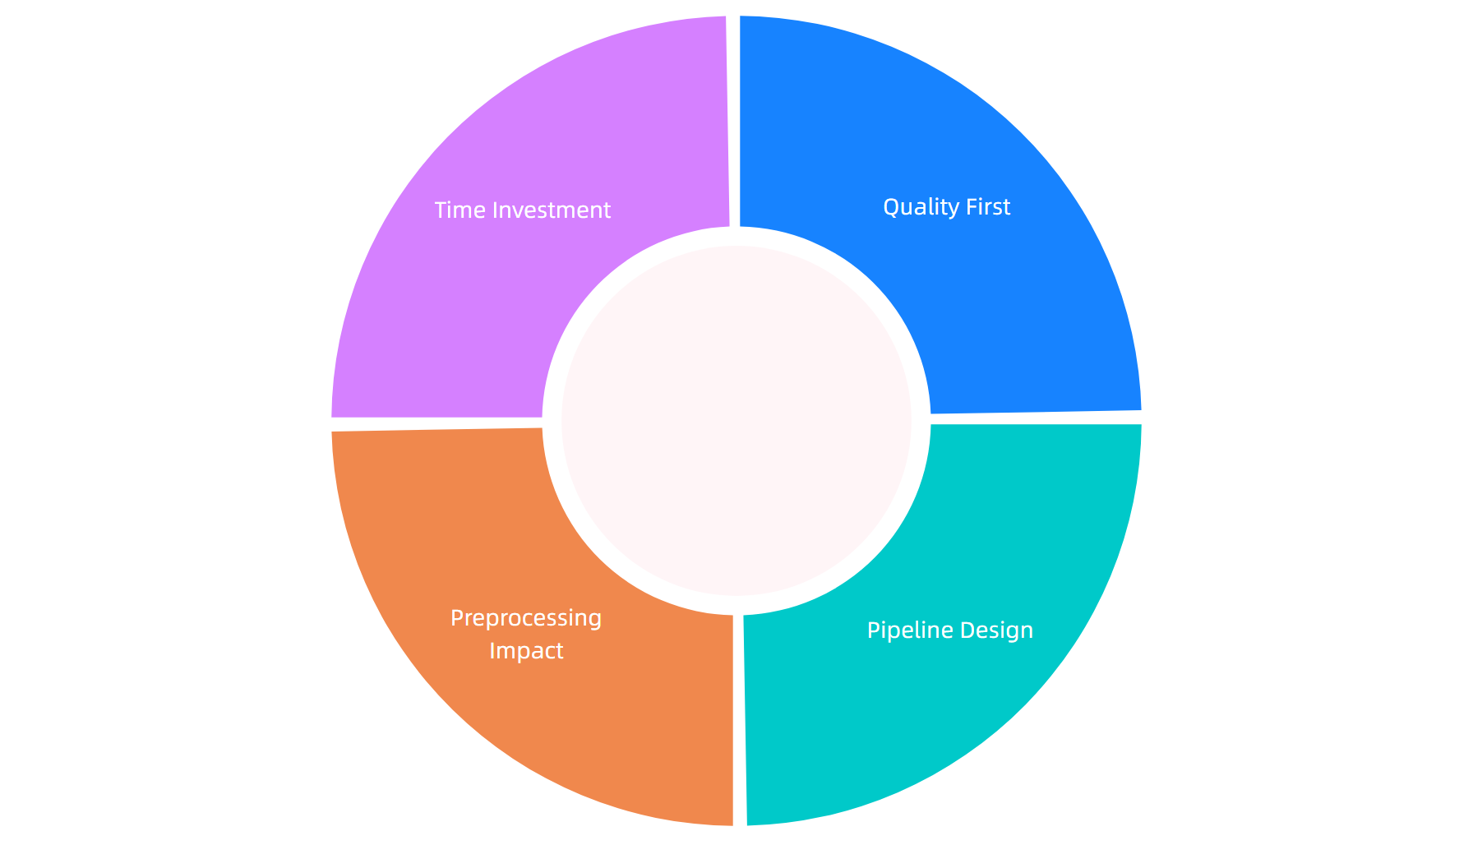
Key takeaways for ML success
Source: Multiple sources, 2024
This material belongs to Tertiary Infotech Pte Ltd (UEN: 20120096W). All Rights Reserved

Slide 46
Activity: Importance of data quality, preprocessing, model pipeline and model training
Activity: Data Pipeline Quality Assessment
Scenario: Your team receives a customer churn dataset with missing values, inconsistent formats, and potential outliers. Design a preprocessing pipeline.
Step 1: Identify data quality issues
Step 2: Select appropriate cleaning techniques
Step 3: Design preprocessing pipeline stages
Step 4: Validate transformation results
Expected Output: Complete preprocessing pipeline documentation with quality metrics
Duration: 25 minutes
This material belongs to Tertiary Infotech Pte Ltd (UEN: 20120096W). All Rights Reserved

Slide 47
LO2 | LU2 | T2: Impact of prompt engineering on the model outputs of generative AI

Slide 48
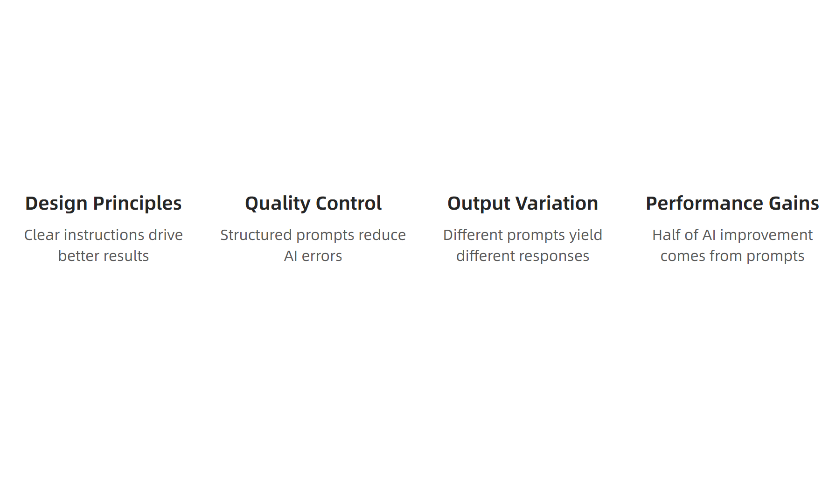
What is Impact of prompt engineering on the model outputs of generative AI?
Source: MIT Sloan, 2024
This material belongs to Tertiary Infotech Pte Ltd (UEN: 20120096W). All Rights Reserved

Slide 49
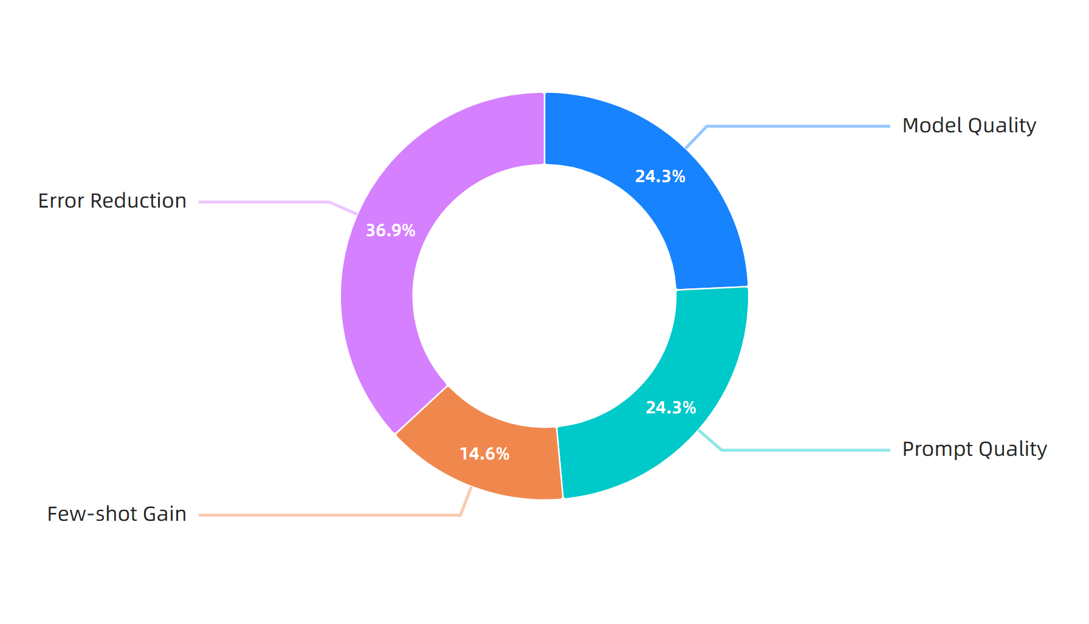
Performance Impact Statistics
Source: MIT Sloan & ArXiv, 2024
This material belongs to Tertiary Infotech Pte Ltd (UEN: 20120096W). All Rights Reserved

Slide 50
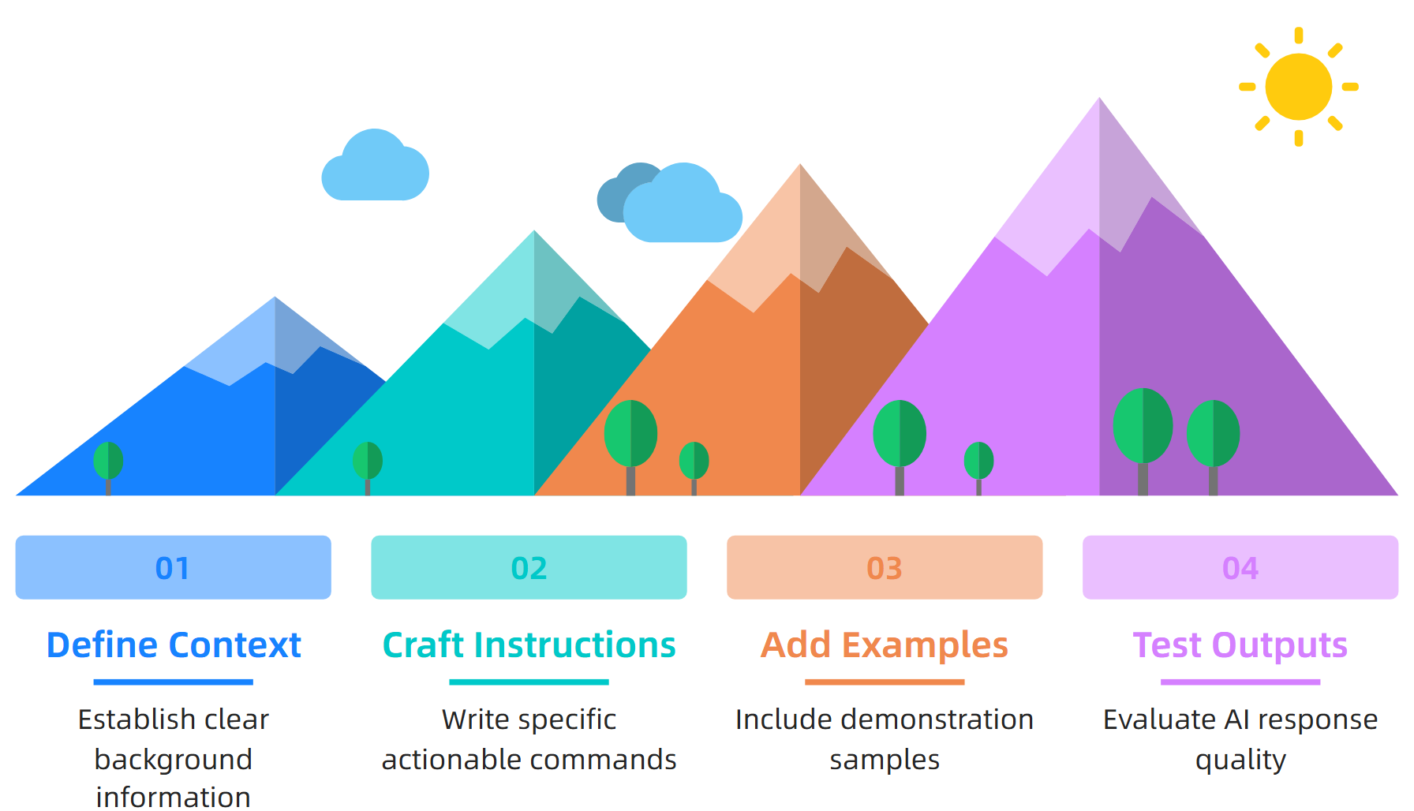
Prompt Engineering Process
Source: OpenAI Best Practices, 2024
This material belongs to Tertiary Infotech Pte Ltd (UEN: 20120096W). All Rights Reserved

Slide 51
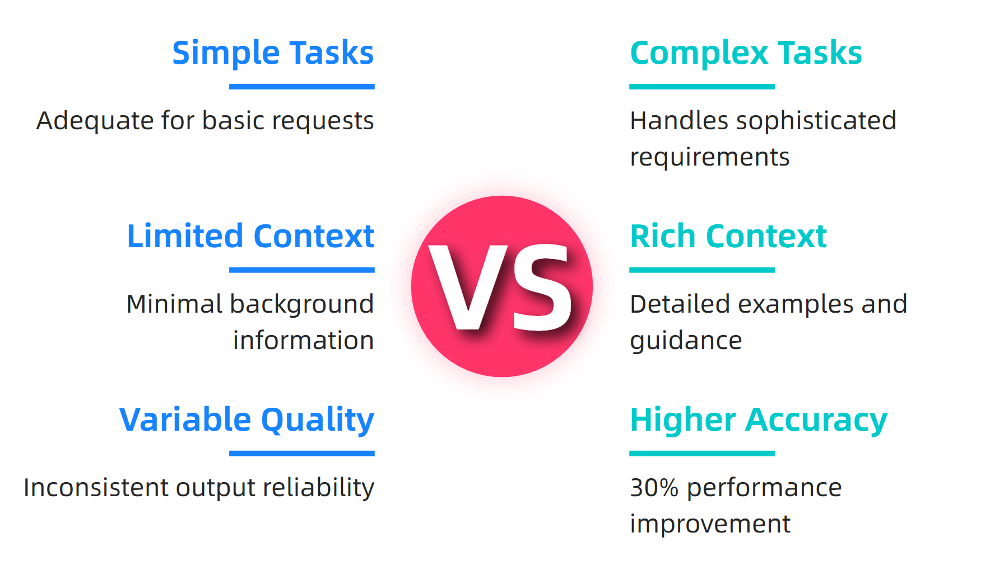
Prompting Strategy Comparison
Source: Medical Research Study, 2025
This material belongs to Tertiary Infotech Pte Ltd (UEN: 20120096W). All Rights Reserved

Slide 52
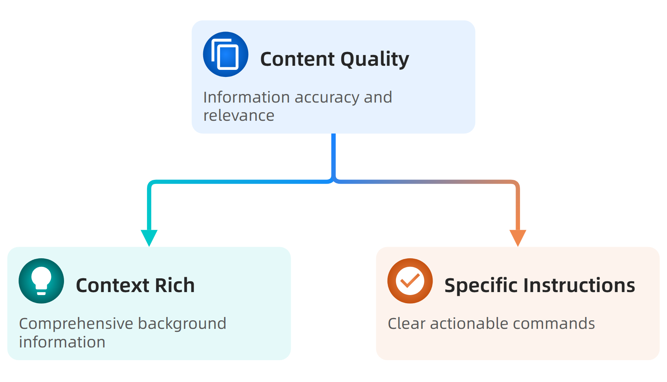
Quality Optimization Factors
Source: IBM Prompt Engineering Guide, 2024
This material belongs to Tertiary Infotech Pte Ltd (UEN: 20120096W). All Rights Reserved

Slide 53
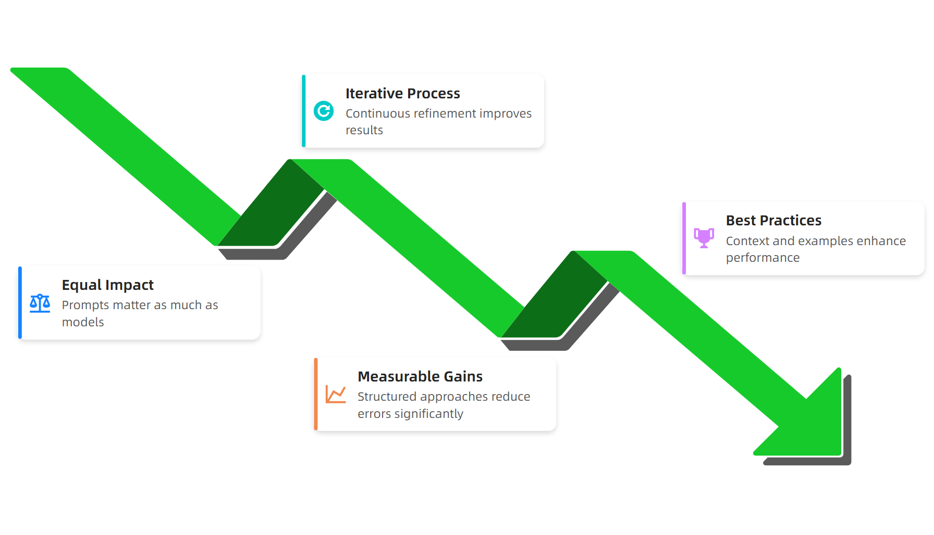
Key Takeaways
Source: Comprehensive Research Review, 2024
This material belongs to Tertiary Infotech Pte Ltd (UEN: 20120096W). All Rights Reserved

Slide 54
Activity: Impact of prompt engineering on the model outputs of generative AI
Activity: Prompt Engineering Workshop
Scenario: You are a data analyst tasked with generating a market research report using AI. Your manager needs accurate insights about consumer trends in sustainable technology adoption.
Step 1: Create a zero-shot prompt asking for consumer trends
Step 2: Design a few-shot prompt with specific examples
Step 3: Test both prompts and compare output quality
Step 4: Refine the better prompt with additional context
Step 5: Document the differences in accuracy and relevance
Expected Output: Two prompt versions with quality comparison analysis
Duration: 25 minutes
This material belongs to Tertiary Infotech Pte Ltd (UEN: 20120096W). All Rights Reserved

Slide 55
LO2 | LU2 | T3: Apply understanding of generative AI principles to use cases

Slide 56
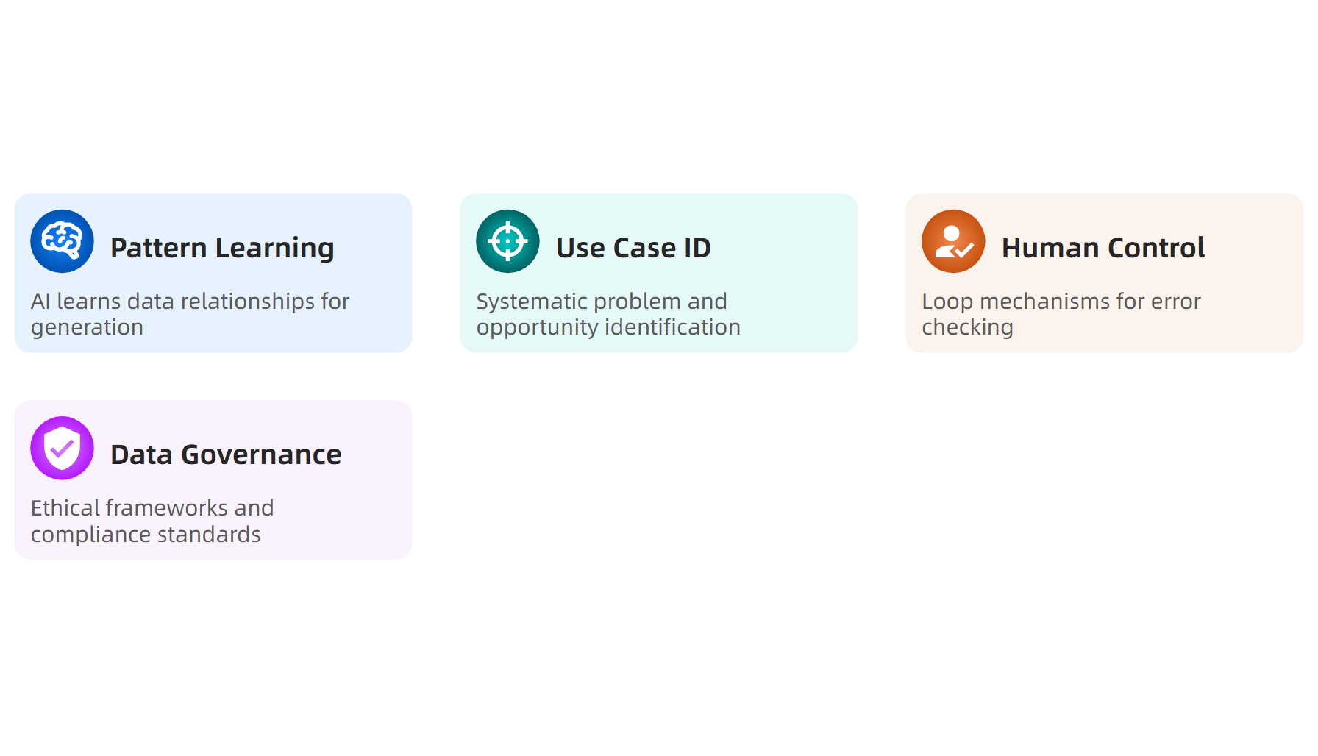
What is Apply understanding of generative AI principles to use cases?
Source: Enterprise Guide to Generative AI, 2024
This material belongs to Tertiary Infotech Pte Ltd (UEN: 20120096W). All Rights Reserved

Slide 57
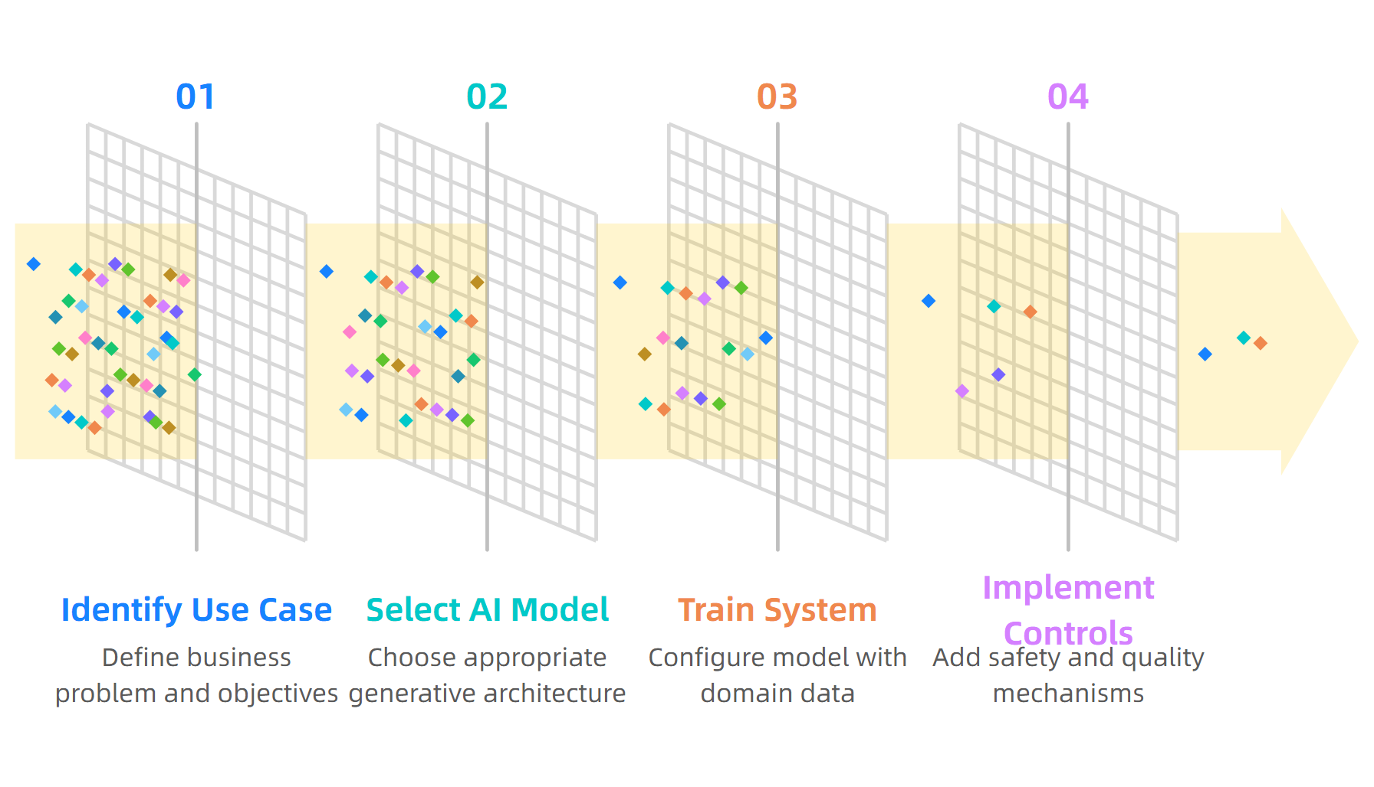
Implementation Process Steps
Source: 101 real-world gen AI use cases, 2024
This material belongs to Tertiary Infotech Pte Ltd (UEN: 20120096W). All Rights Reserved

Slide 58
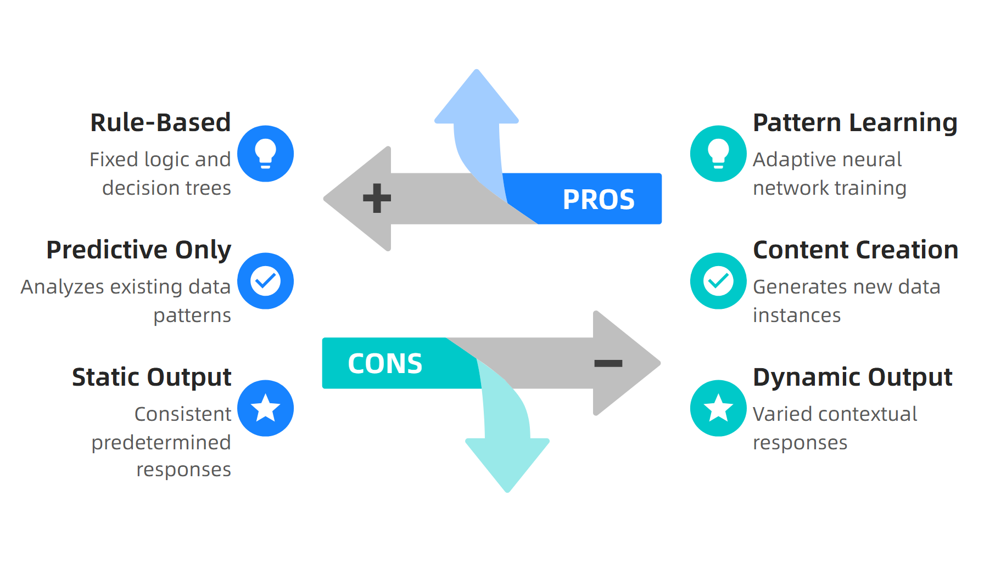
Traditional vs Generative AI
Source: Generative AI Use cases and implementation, 2024
This material belongs to Tertiary Infotech Pte Ltd (UEN: 20120096W). All Rights Reserved

Slide 59
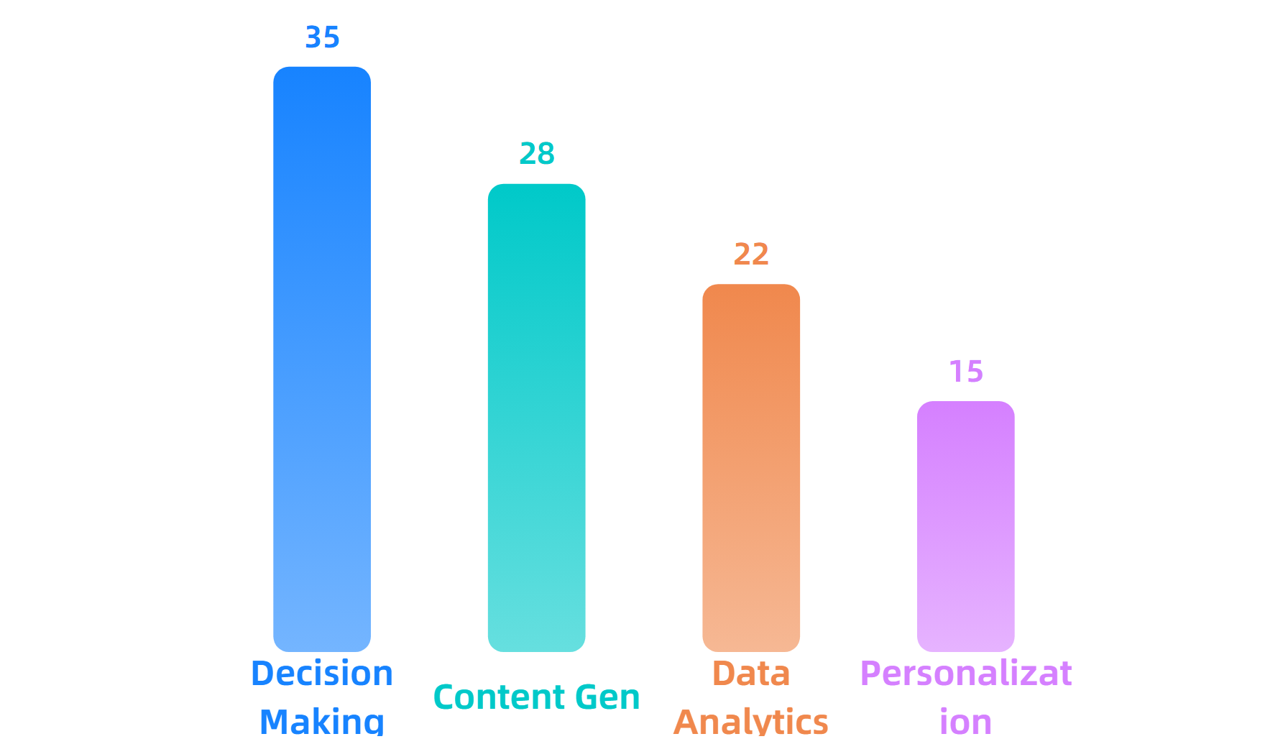
Industry Impact Statistics
Source: Gartner, Analytics8, Google Cloud, Deloitte 2024
This material belongs to Tertiary Infotech Pte Ltd (UEN: 20120096W). All Rights Reserved

Slide 60
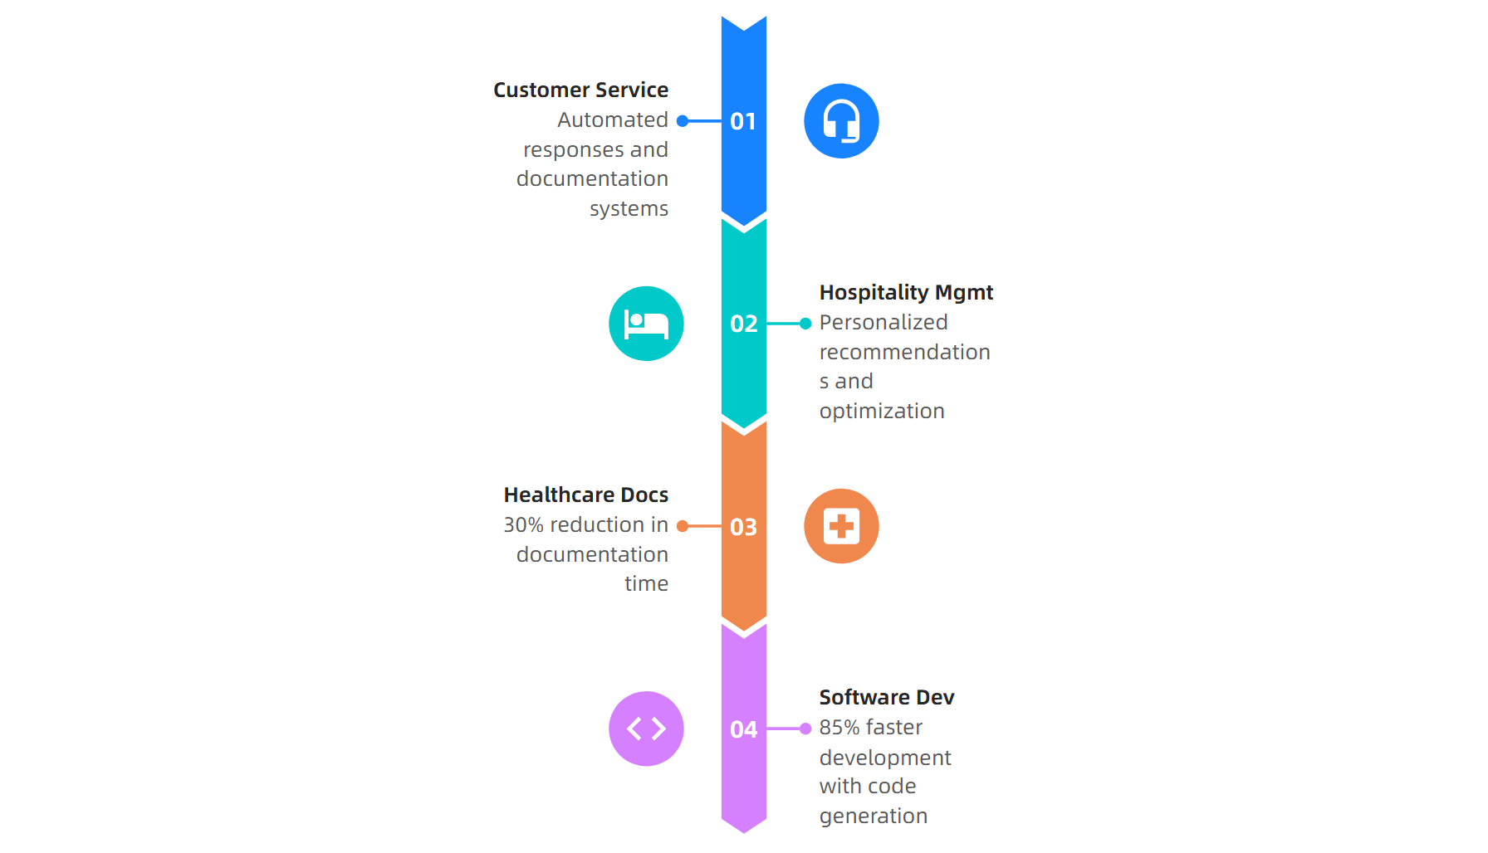
Real-World Application Areas
Source: AI use cases by industry, Deloitte 2024
This material belongs to Tertiary Infotech Pte Ltd (UEN: 20120096W). All Rights Reserved

Slide 61
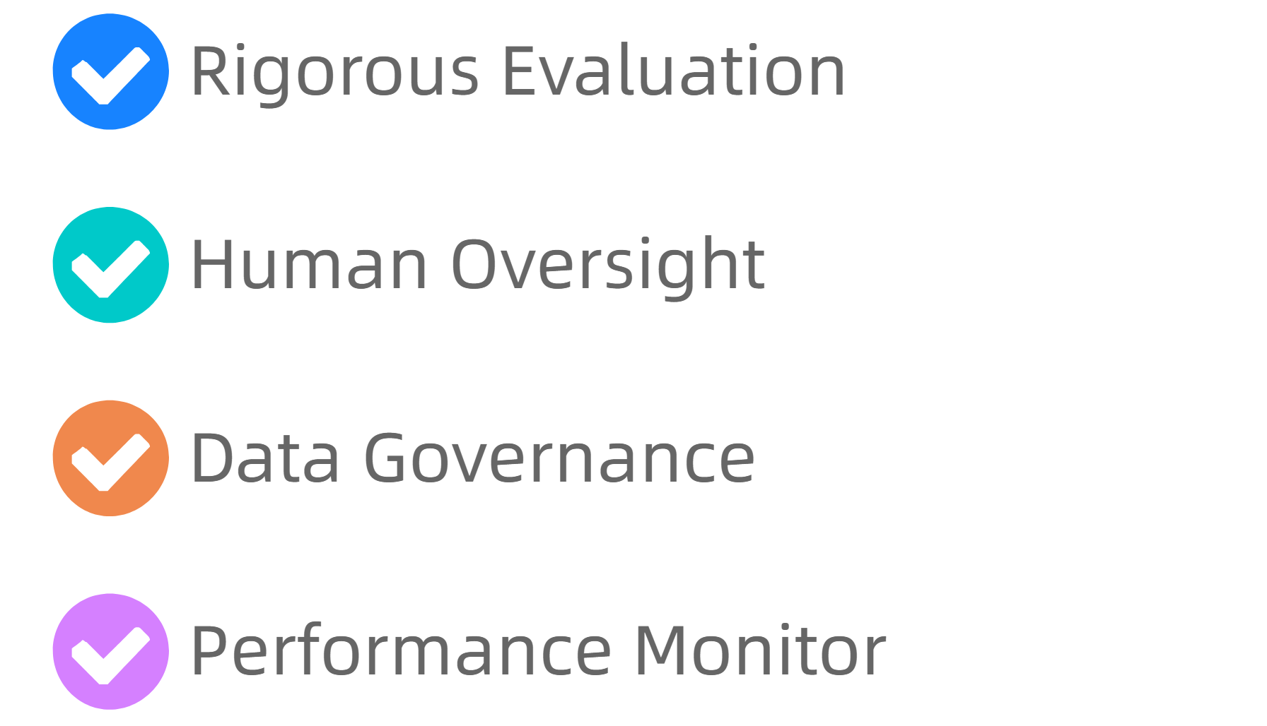
Key Implementation Takeaways
Source: Enterprise Guide to Generative AI, 2024
This material belongs to Tertiary Infotech Pte Ltd (UEN: 20120096W). All Rights Reserved

Slide 62
Activity: Apply understanding of generative AI principles to use cases
Activity: GenAI Use Case Assessment
Scenario: Your hospitality company wants to implement GenAI for guest services. Evaluate a specific use case (chatbot, personalized recommendations, or operational optimization) using the implementation framework.
Step 1: Identify specific business problem and success metrics
Step 2: Select appropriate GenAI model type and capabilities
Step 3: Design human oversight and quality control mechanisms
Step 4: Create deployment plan with performance monitoring
Expected Output: Completed use case evaluation with implementation roadmap and risk mitigation strategies
Duration: 25 minutes
This material belongs to Tertiary Infotech Pte Ltd (UEN: 20120096W). All Rights Reserved

Slide 63
LO2 | LU2 | T4: Analyse generative AI models' performance metrics and evaluate the influence of prompt variations

Slide 64
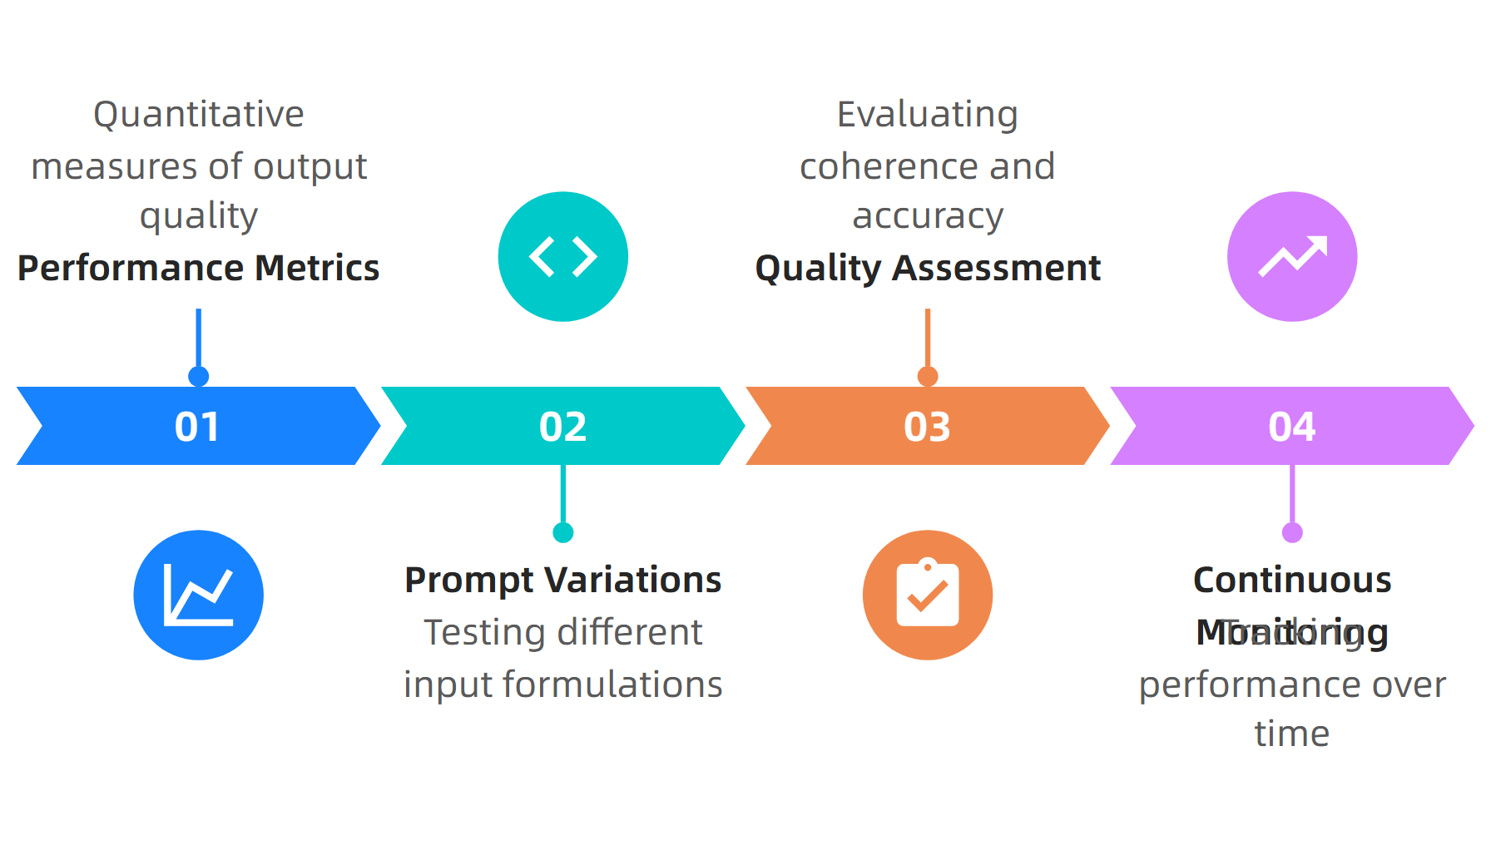
What is Analyse generative AI models' performance metrics and evaluate the influence of prompt variations?
Source: Google Cloud Documentation, 2024
This material belongs to Tertiary Infotech Pte Ltd (UEN: 20120096W). All Rights Reserved

Slide 65
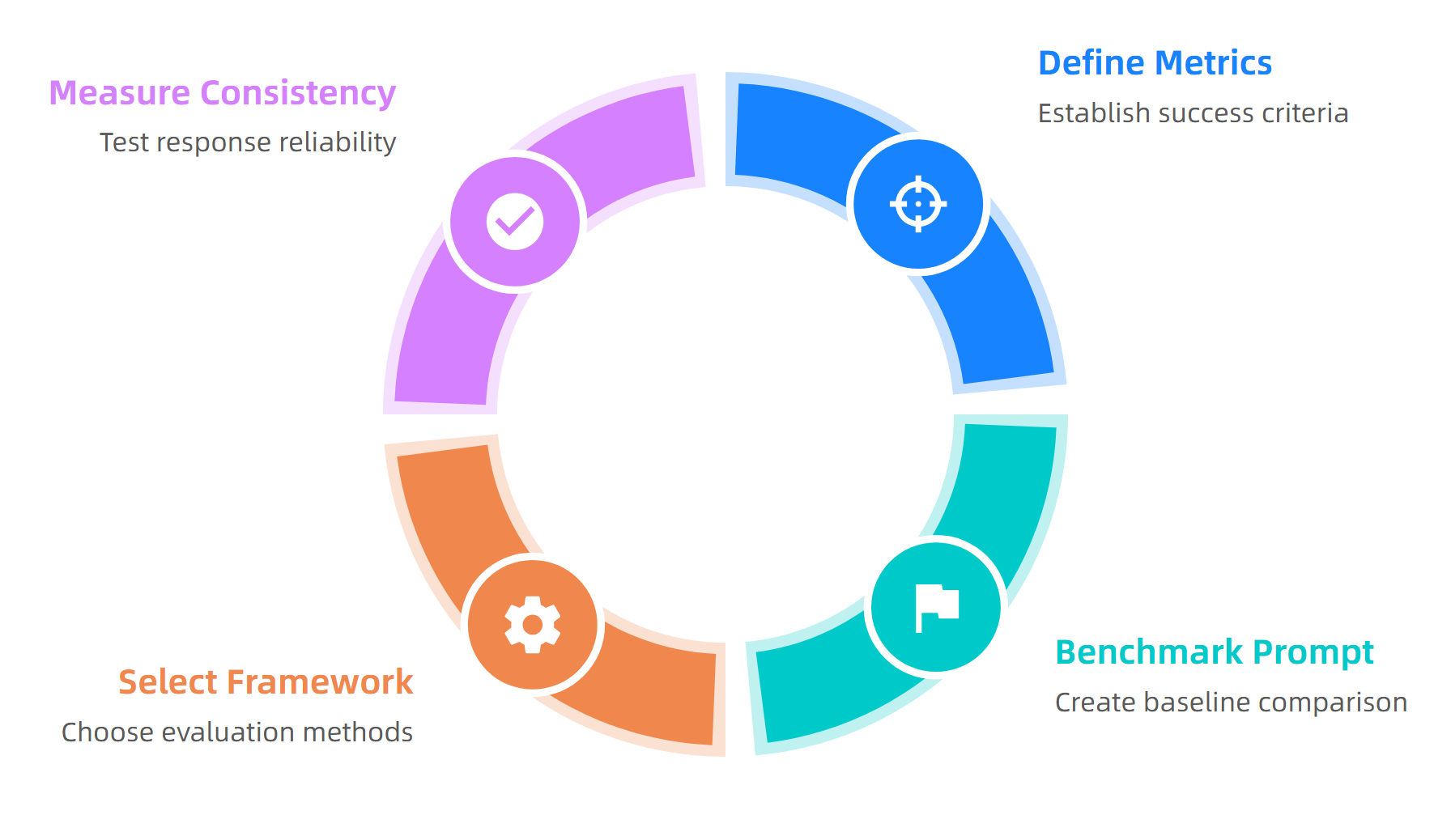
Evaluation Process Steps
Source: Evaluating Prompt Effectiveness Guide, 2024
This material belongs to Tertiary Infotech Pte Ltd (UEN: 20120096W). All Rights Reserved

Slide 66
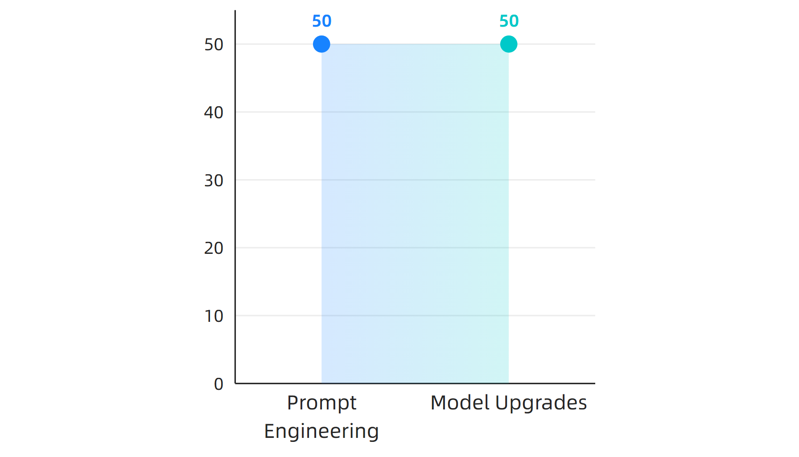
Performance Impact Statistics
Source: MIT Sloan Study, 2024 (1,900 participants)
This material belongs to Tertiary Infotech Pte Ltd (UEN: 20120096W). All Rights Reserved

Slide 67
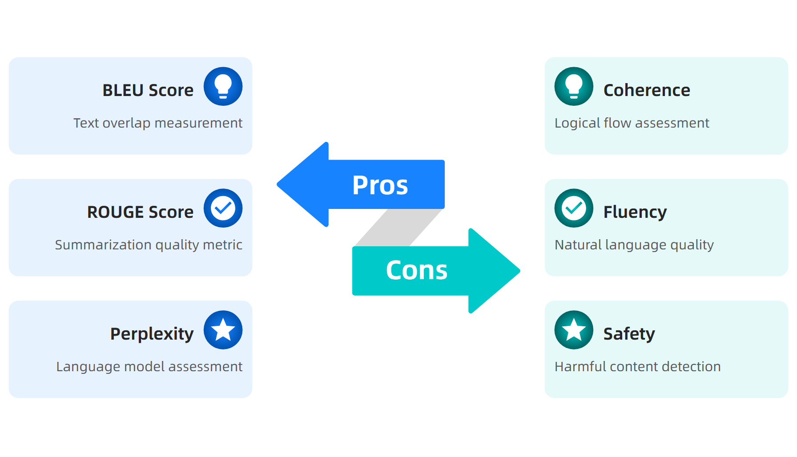
Evaluation Methods Comparison
Source: AI Metrics that Matter Guide, 2024
This material belongs to Tertiary Infotech Pte Ltd (UEN: 20120096W). All Rights Reserved

Slide 68
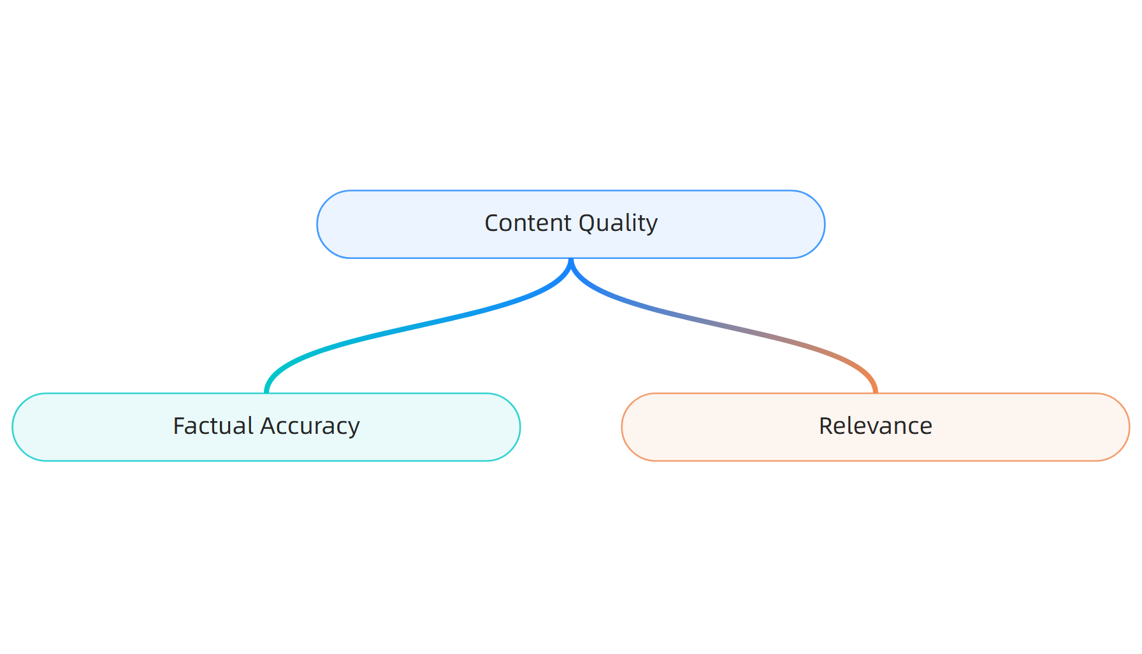
Key Quality Dimensions
Source: Comprehensive Evaluation Guide, 2024
This material belongs to Tertiary Infotech Pte Ltd (UEN: 20120096W). All Rights Reserved

Slide 69

Key Takeaways
Source: Multiple studies synthesis, 2024
This material belongs to Tertiary Infotech Pte Ltd (UEN: 20120096W). All Rights Reserved

Slide 70
Activity: Analyse generative AI models' performance metrics and evaluate the influence of prompt variations
Activity: Prompt Performance Lab
Scenario: Your organization is implementing a customer service chatbot. You need to evaluate three different prompt strategies for handling product inquiries and measure their effectiveness using appropriate metrics.
Step 1: Design three prompt variations (zero-shot, few-shot, chain-of-thought)
Step 2: Define evaluation criteria (accuracy, response time, customer satisfaction)
Step 3: Test prompts with 10 sample inquiries and measure consistency
Step 4: Calculate performance metrics and identify best-performing approach
Step 5: Document findings and recommend optimization strategies
Expected Output: Comparative analysis report with metrics, recommendations, and implementation plan
Duration: 25 minutes
This material belongs to Tertiary Infotech Pte Ltd (UEN: 20120096W). All Rights Reserved

Slide 71
LO3 | LU3 | T1: Generative AI model workings, including training data, algorithms, and outputs

Slide 72
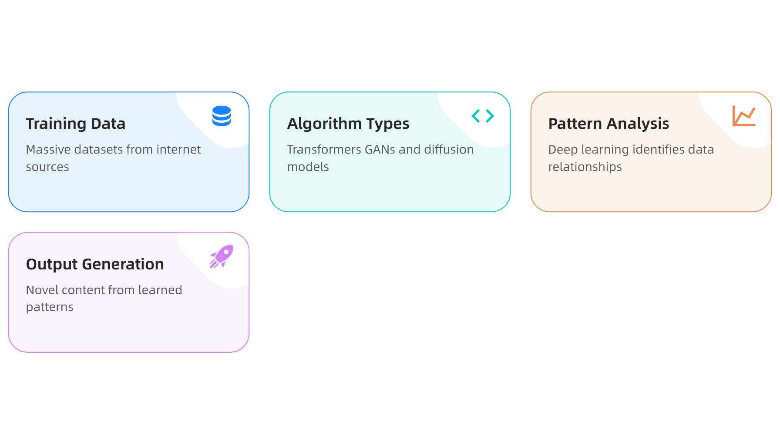
What is Generative AI model workings, including training data, algorithms, and outputs?
Source: MIT News, IBM 2024
This material belongs to Tertiary Infotech Pte Ltd (UEN: 20120096W). All Rights Reserved

Slide 73
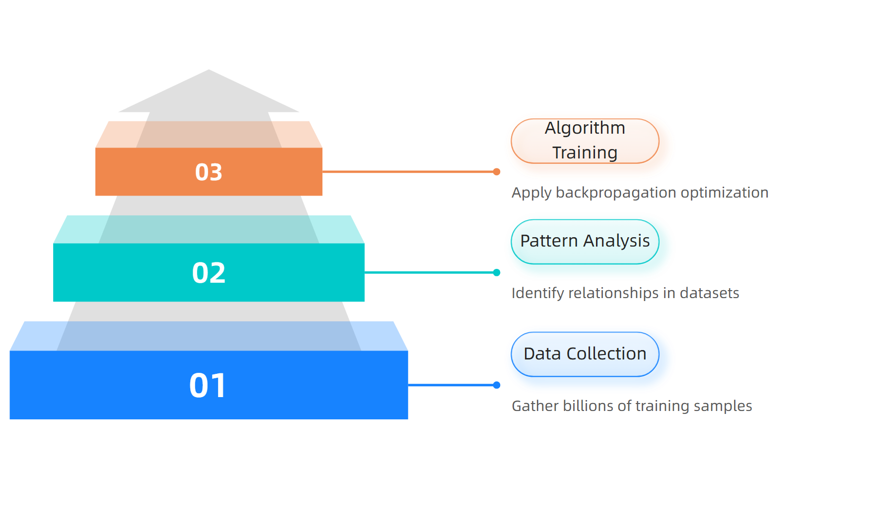
Training Process Workflow
Source: MIT News, NVIDIA 2024
This material belongs to Tertiary Infotech Pte Ltd (UEN: 20120096W). All Rights Reserved

Slide 74
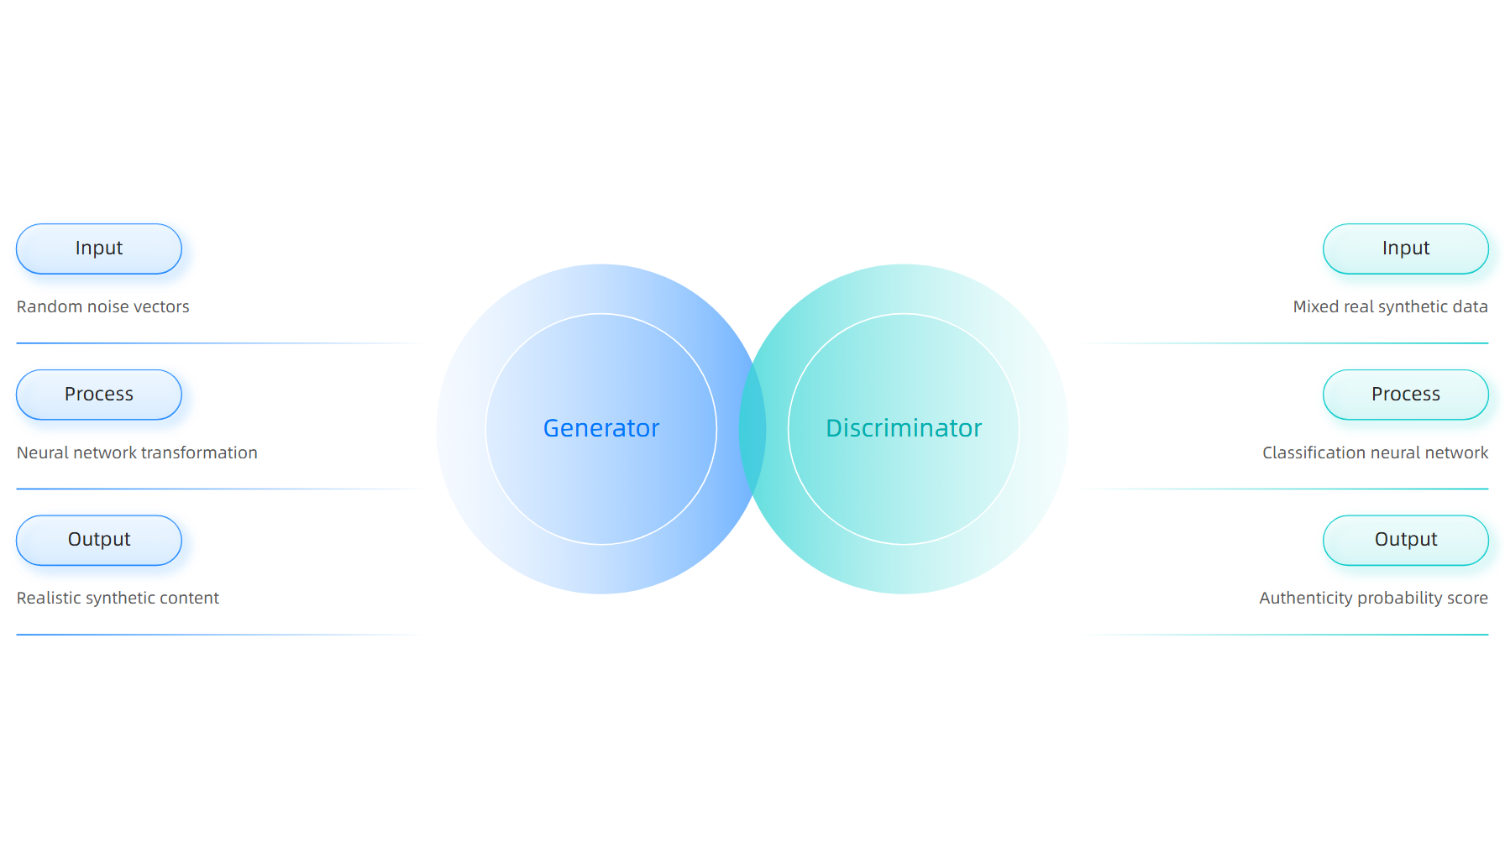
Algorithm Architecture Comparison
Source: Wikipedia, IBM 2024
This material belongs to Tertiary Infotech Pte Ltd (UEN: 20120096W). All Rights Reserved

Slide 75
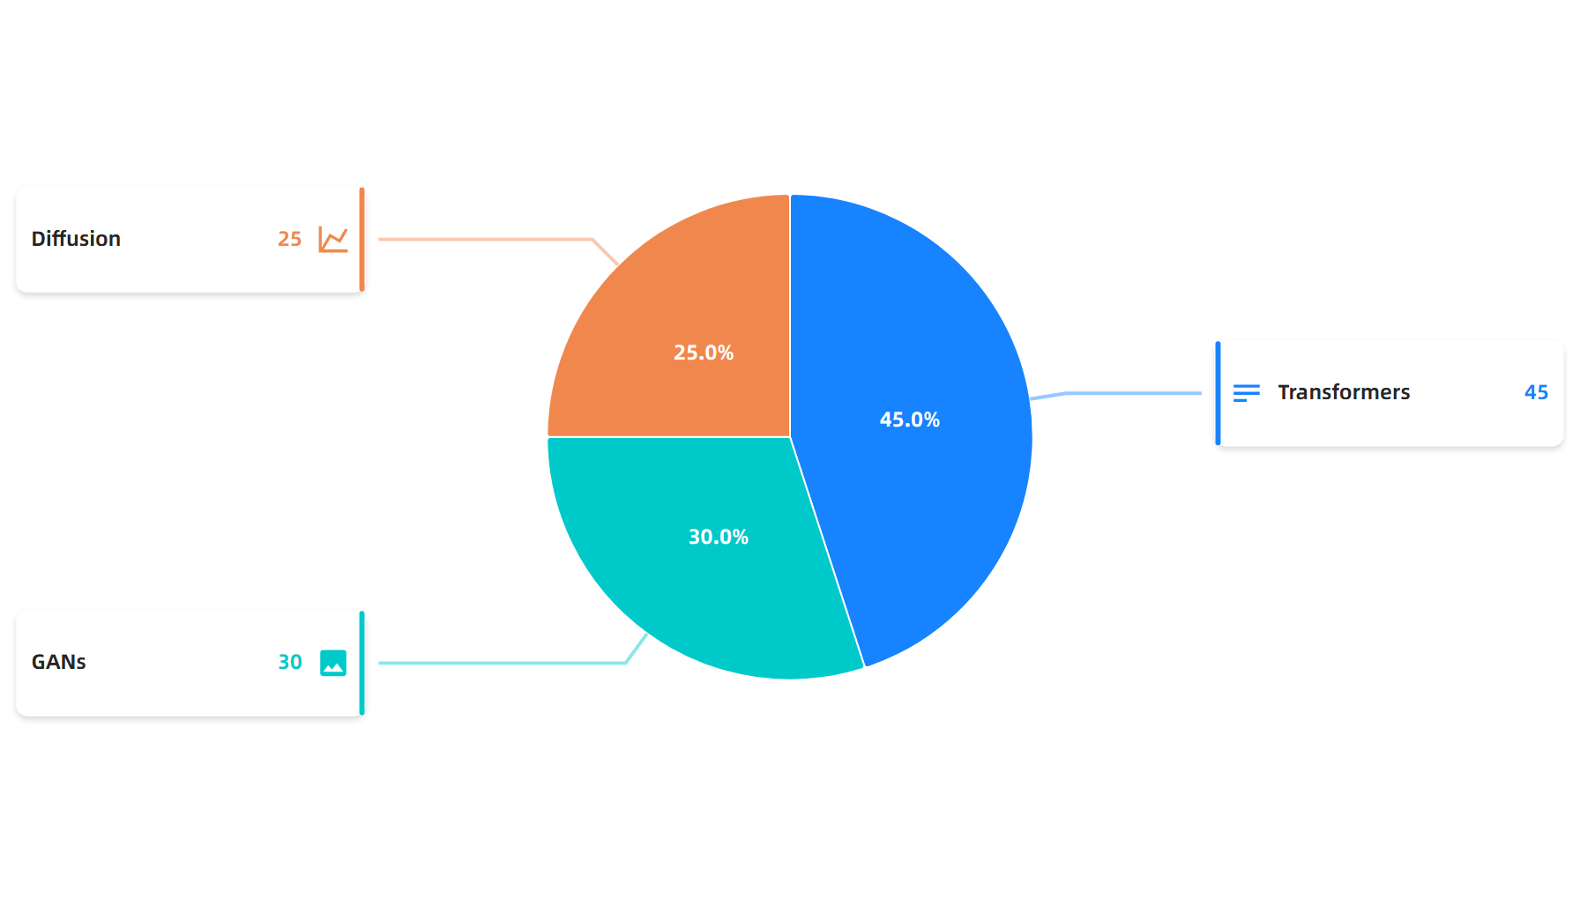
Algorithm Usage Statistics
Source: Industry Analysis 2024
This material belongs to Tertiary Infotech Pte Ltd (UEN: 20120096W). All Rights Reserved

Slide 76
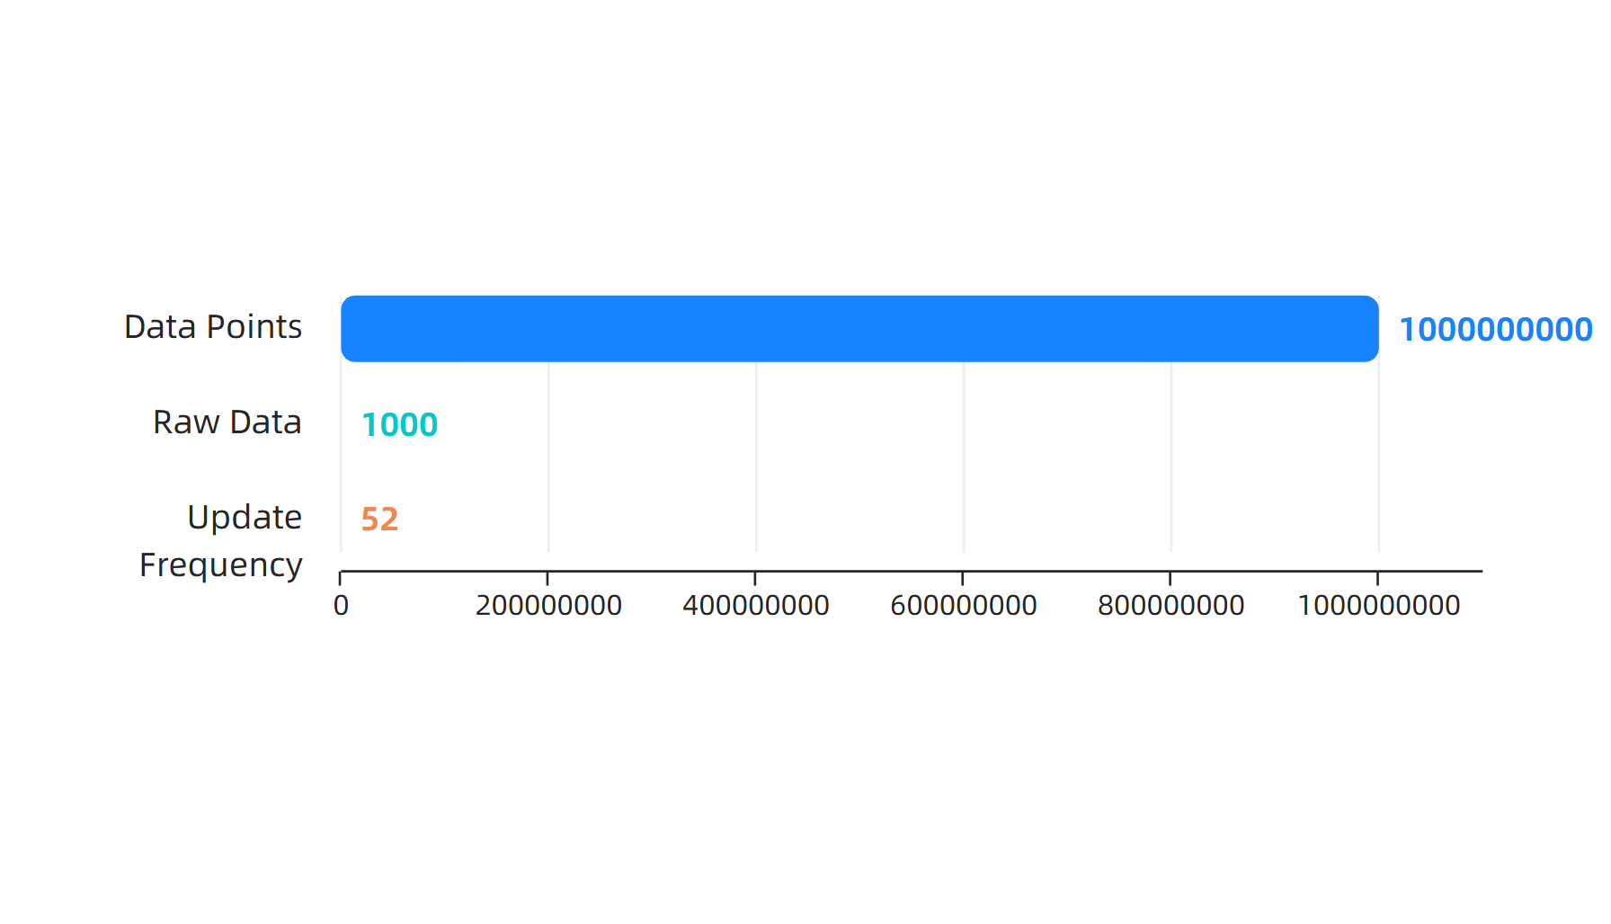
Training Scale Requirements
Source: IBM, NVIDIA, MIT 2024
This material belongs to Tertiary Infotech Pte Ltd (UEN: 20120096W). All Rights Reserved

Slide 77
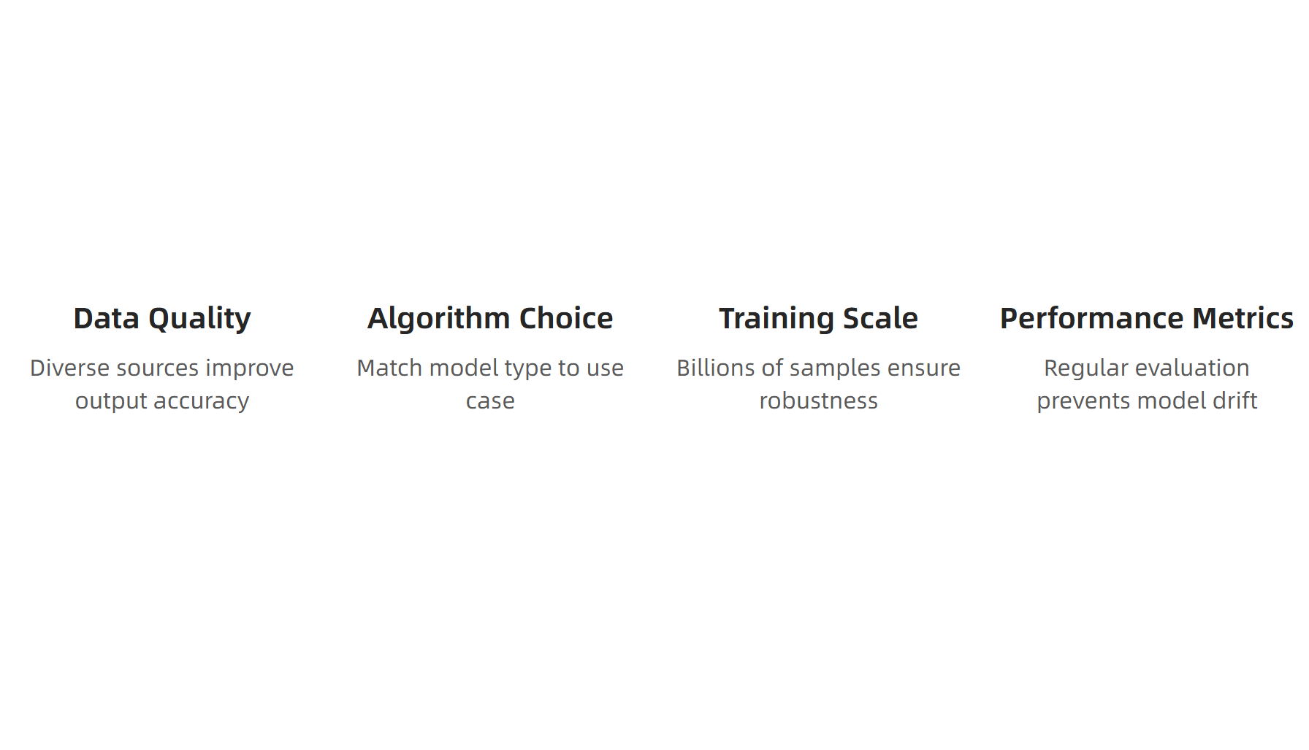
Key Takeaways
Source: ICO, MIT, IBM 2024
This material belongs to Tertiary Infotech Pte Ltd (UEN: 20120096W). All Rights Reserved

Slide 78
Activity: Generative AI model workings, including training data, algorithms, and outputs
Activity: Model Architecture Analysis
Scenario: Your organization is selecting a generative AI model for customer service automation. You need to evaluate three different algorithm approaches (Transformers, GANs, Diffusion) based on your specific requirements: handling natural language queries, generating response content, and maintaining accuracy over time.
Step 1: Review each algorithm's strengths and limitations
Step 2: Map your use case requirements to algorithm capabilities
Step 3: Assess training data needs and availability
Step 4: Recommend optimal algorithm with justification
Expected Output: A comparative analysis document with algorithm recommendation and implementation considerations
Duration: 25 minutes
This material belongs to Tertiary Infotech Pte Ltd (UEN: 20120096W). All Rights Reserved

Slide 79
LO3 | LU3 | T2: Identify the ethical implications and societal impact of AI-generated content

Slide 80

What is Identify the ethical implications and societal impact of AI-generated content?
Source: UNESCO Ethics of AI, 2024
This material belongs to Tertiary Infotech Pte Ltd (UEN: 20120096W). All Rights Reserved

Slide 81

Ethical Assessment Process
Source: Interdisciplinary Perspective, 2024
This material belongs to Tertiary Infotech Pte Ltd (UEN: 20120096W). All Rights Reserved

Slide 82

Ethical Concern Distribution
Source: Multiple Ethics Studies, 2024
This material belongs to Tertiary Infotech Pte Ltd (UEN: 20120096W). All Rights Reserved

Slide 83

Pre-AI vs AI Era Comparison
Source: AI Content Creation Analysis, 2024
This material belongs to Tertiary Infotech Pte Ltd (UEN: 20120096W). All Rights Reserved

Slide 84

Global Regulatory Framework
Source: 2025 AI Regulations, AIMutiple 2024
This material belongs to Tertiary Infotech Pte Ltd (UEN: 20120096W). All Rights Reserved

Slide 85

Key Takeaways
Source: AI Ethics Management Guide, 2024
This material belongs to Tertiary Infotech Pte Ltd (UEN: 20120096W). All Rights Reserved

Slide 86
Activity: Identify the ethical implications and societal impact of AI-generated content
Activity: AI Ethics Case Analysis
Scenario: Your company is implementing an AI content generation tool for marketing. The legal team has flagged potential bias in customer targeting, privacy concerns from training data, and regulatory compliance requirements under the new EU AI Act.
Step 1: Identify all stakeholders affected by the AI implementation
Step 2: Assess bias risks in the training data and targeting algorithms
Step 3: Design human oversight processes for content review and approval
Step 4: Create compliance checklist for EU AI Act disclosure requirements
Expected Output: Comprehensive ethics assessment report with risk mitigation strategies
Duration: 20 minutes
This material belongs to Tertiary Infotech Pte Ltd (UEN: 20120096W). All Rights Reserved

Slide 87
LO3 | LU3 | T3: Analyse limitations and potential biases in AI-generated content

Slide 88

What is Analyse limitations and potential biases in AI-generated content?
Source: MIT Sloan, 2024
This material belongs to Tertiary Infotech Pte Ltd (UEN: 20120096W). All Rights Reserved

Slide 89

Types of Bias in AI Systems
Source: MIT Sloan, Nature, AIM Multiple 2024
This material belongs to Tertiary Infotech Pte Ltd (UEN: 20120096W). All Rights Reserved

Slide 90

Bias Mitigation Process
Source: NIST Standards, 2024
This material belongs to Tertiary Infotech Pte Ltd (UEN: 20120096W). All Rights Reserved

Slide 91

Traditional vs AI Content
Source: MIT Sloan, Nature 2024
This material belongs to Tertiary Infotech Pte Ltd (UEN: 20120096W). All Rights Reserved

Slide 92

Validation Framework Hierarchy
Source: NIST, MIT Sloan 2024
This material belongs to Tertiary Infotech Pte Ltd (UEN: 20120096W). All Rights Reserved

Slide 93

Key Takeaways for Ethical AI
Source: Nature, MIT Sloan 2024
This material belongs to Tertiary Infotech Pte Ltd (UEN: 20120096W). All Rights Reserved

Slide 94
Activity: Analyse limitations and potential biases in AI-generated content
Activity: AI Content Bias Assessment
Scenario: Your organization uses AI to generate marketing content for a diverse customer base. Recent feedback suggests potential bias issues in the generated materials.
Step 1: Review provided AI-generated content samples
Step 2: Apply NIST bias identification framework
Step 3: Document identified bias patterns and sources
Step 4: Recommend specific mitigation strategies
Step 5: Design validation process for future content
Expected Output: Comprehensive bias assessment report with actionable recommendations
Duration: 25 minutes
This material belongs to Tertiary Infotech Pte Ltd (UEN: 20120096W). All Rights Reserved

Slide 95
Summary & Q&A

Slide 96

Cert & TRAQOM Survey (Mandatory)
https://lms-tms.tertiaryinfotech.com/

Slide 97
Digital Attendance
It is mandatory for you to take both AM, PM and Assessment digital attendance.
Please scan the QR code from your mobile phone camera and submit your attendance.
Ensure your attendance is recorded for all course days.
This is required for funding and certification purposes.
This material belongs to Tertiary Infotech Pte Ltd (UEN: 20120096W). All Rights Reserved

Slide 98
Final Assessment

Slide 99
Support
If you have any enquiries during and after the class, you can contact us below
Email: enquiry@tertiaryinfotech.com
Tel: +65 6318 4588
Website: www.tertiarycourses.com.sg
This material belongs to Tertiary Infotech Pte Ltd (UEN: 20120096W). All Rights Reserved

Slide 100
Thank You!

